Slide 1

School Consolidations
August 10, 2026

Slide 2

INTRODUCTION
Boundary changes were a recommendation of the 2024-25 consolidation process, and our team was engaged specifically to facilitate that boundary change process.
We developed a set of boundary adjustment options, while noting that boundary changes alone would not resolve the district’s underutilization.
Those options were shared with the community, and the feedback we received pointed toward consolidation as the more sustainable path.
At the same time, the district’s financial outlook has continued to tighten, and the adopted budget is contingent on the closure of two schools.
Tonight, we present three consolidation options for the Board’s consideration, along with the analysis supporting each.
HPMLEADERSHIP.COM

Slide 3
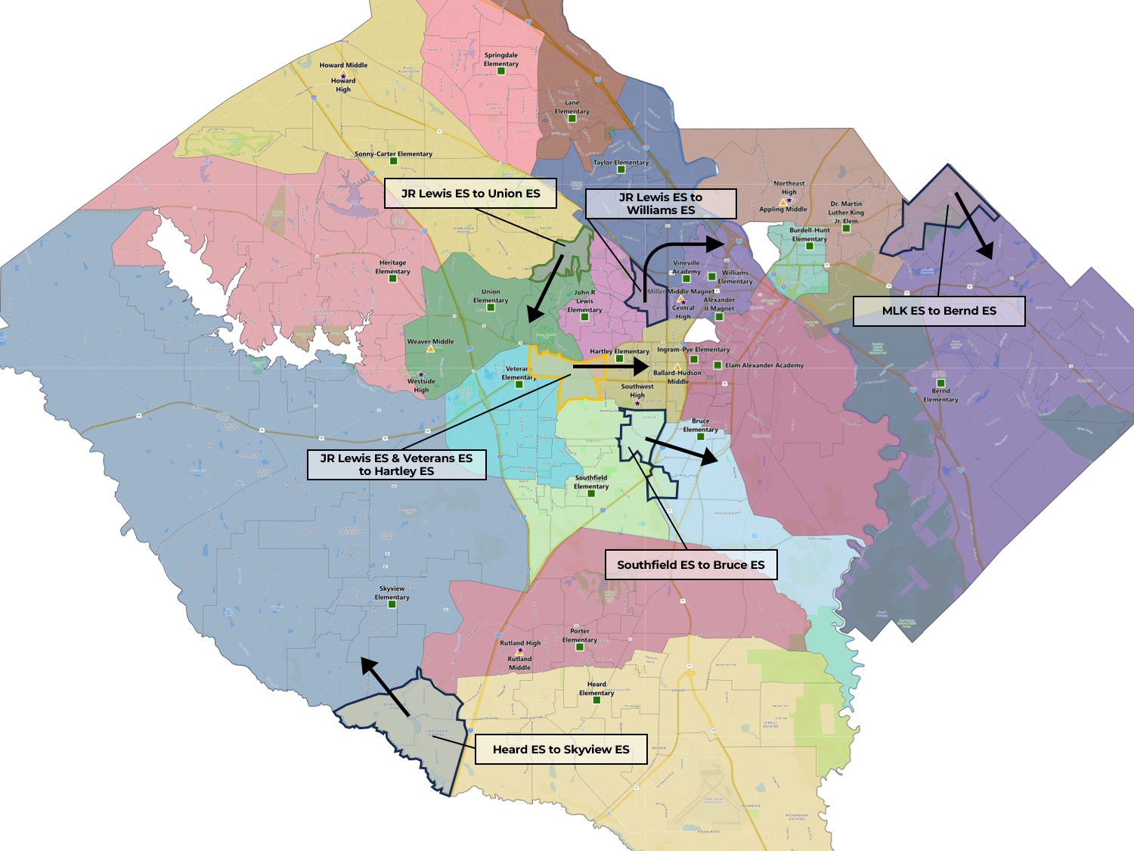
ATTENDANCE ZONE OPTIONS (Review)
Option 1
  District-wide attendance zone changes to balance utilization and improve feeder patterns.
  11 of 19 elementary attendance zones and 5 of 6 middle and high school attendance zones are impacted
Option 2A
  Option 2A converts Williams ES to an Early Learning Center
  Williams ES students redistributed to Hartley ES and Ingram ES
Option 2B
  Option 2A converts Williams ES to an Early Learning Center
  All Williams ES students redistributed to Ingram ES
HPMLEADERSHIP.COM

Slide 4
SURVEY RESPONSES
General Sentiment
Option 1 was generally viewed as the most acceptable of the three proposals.
Many respondents felt Option 1 is a short-term fix rather than a long-term solution.
Centralizing Pre-K at Williams received significant opposition across stakeholder groups.
Transportation, childcare logistics, and splitting siblings between schools were the most common concerns.
Stakeholders strongly preferred keeping Pre-K programs within neighborhood elementary schools.
Volume of Response
331 survey responses since 4/16
50 attendees at the 4/20 community meeting
Nearly 30% of online responses identified with Skyview ES.
HPMLEADERSHIP.COM

Slide 5
LONG-TERM FACILITIES STRATEGY
Due to funding allocation of the dollars to elementary schools, it is a benefit to students to increase school size above 600 students (This does not impact class size).
  This allows more resources per dollar to be allocated at each elementary school.
This cannot happen immediately, but the District should prioritize capital projects that move in this direction.
Given that there is excess capacity and numerous small schools. Capital investment should be prioritized in schools that have capacities above 600 or the projects should increase the capacity of smaller schools.
The upcoming Facilities Study will help to inform and prioritize this strategy.
HPMLEADERSHIP.COM

Slide 6
Below Minimum Program State Funding Elementary School
Enrollment ≤ 450 Includes:
= State Funding
Principal
Half Nurse
Half AP
Guidance
= Local Funding
Media Specialist
Art Teacher
Music Teacher
P.E. Teacher
HPMLEADERSHIP.COM

Slide 7

Minimum Program State Funding Elementary School
Enrollment > 450 Includes:
= State Funding
Principal
Half Nurse
Half AP
Guidance
= Local Funding
Media Specialist
Art Teacher
Music Teacher
P.E. Teacher
Pick 1 of the 3
HPMLEADERSHIP.COM

Slide 8
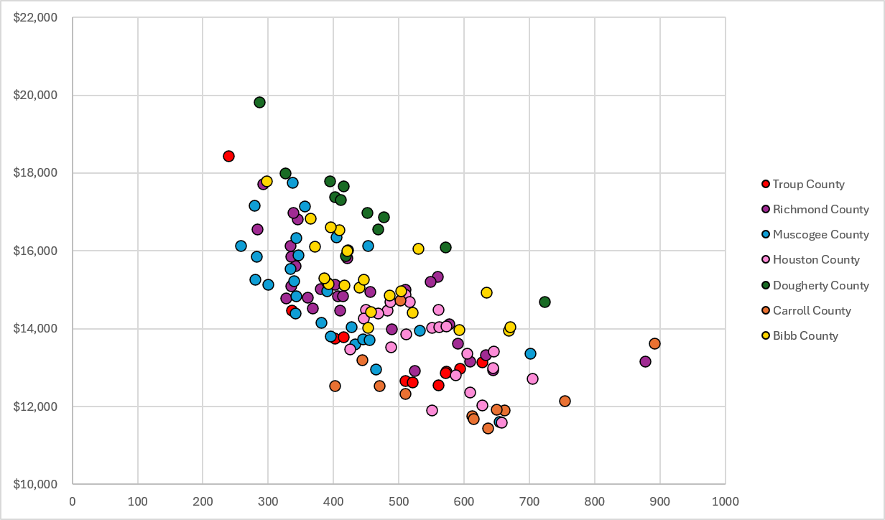
COST PER STUDENT
Bibb County spends slightly more per student than average compared to peer systems across the state.
Dougherty County (Albany) spends consistently more per student.
Carroll County (Carrollton) spends consistently less per student.
Source: Georgia DoE
HPMLEADERSHIP.COM

Slide 9
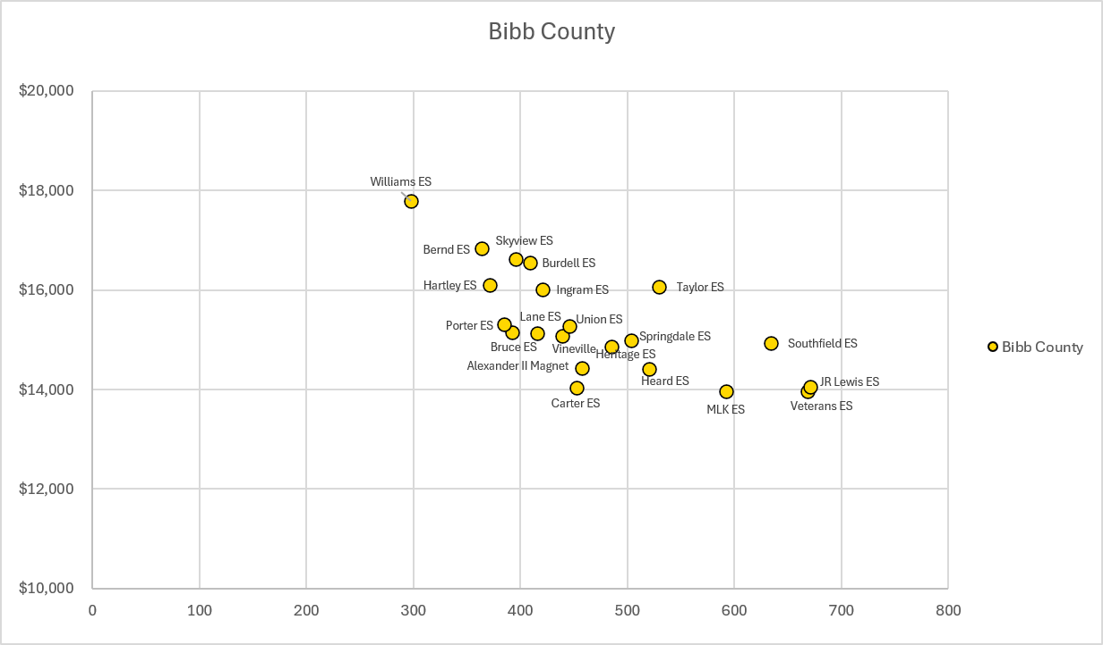
COST PER STUDENT
There is a correlation between decreasing cost per student and increasing enrollment sizes.
If enrollment is above 550, cost per student is typically below $15,000 per year.
Source: Georgia DoE
HPMLEADERSHIP.COM

Slide 10

Consolidation Options

Slide 11
FACTORS CONSIDERED
Student Impact
Academic and Programmatic Opportunities
Feeder Pattern Alignment
Walkability and Transportation Impacts
Community Considerations
Community Input and Stakeholder Feedback
Future Community Growth and Development
Facilities
Facility Condition and Future Capital Needs
Facility Capacity and Utilization
Georgia Department of Education School Size Targets
Financial Sustainability
Operational Efficiency and Financial Sustainability
Per-Pupil Expenditures
Enrollment Trends and Long-Term Projections
HPMLEADERSHIP.COM

Slide 12
OPTIONS OVERVIEW & RATIONALE
Option 1 – Carter ES & Hartley ES close
Option 2 – Carter ES closes
Independent Option –VIP Academy closes
RATIONALE
School | Reasons it is being considered for consolidation
Carter Elementary | 100% Transportation Eligible School (No Walk Zone). Buses would take students to different schools12, no additional drivers would be needed. Needs a renovation, those dollars can be reallocated to more suitable facilities.
Hartley Elementary | Enrollment less than 450 In close proximity to the recently renovated Ingram ES
VIP Academy | Originally launched as a temporary online program during COVID Declining enrollment resulting in increased cost per student
HPMLEADERSHIP.COM

Slide 13
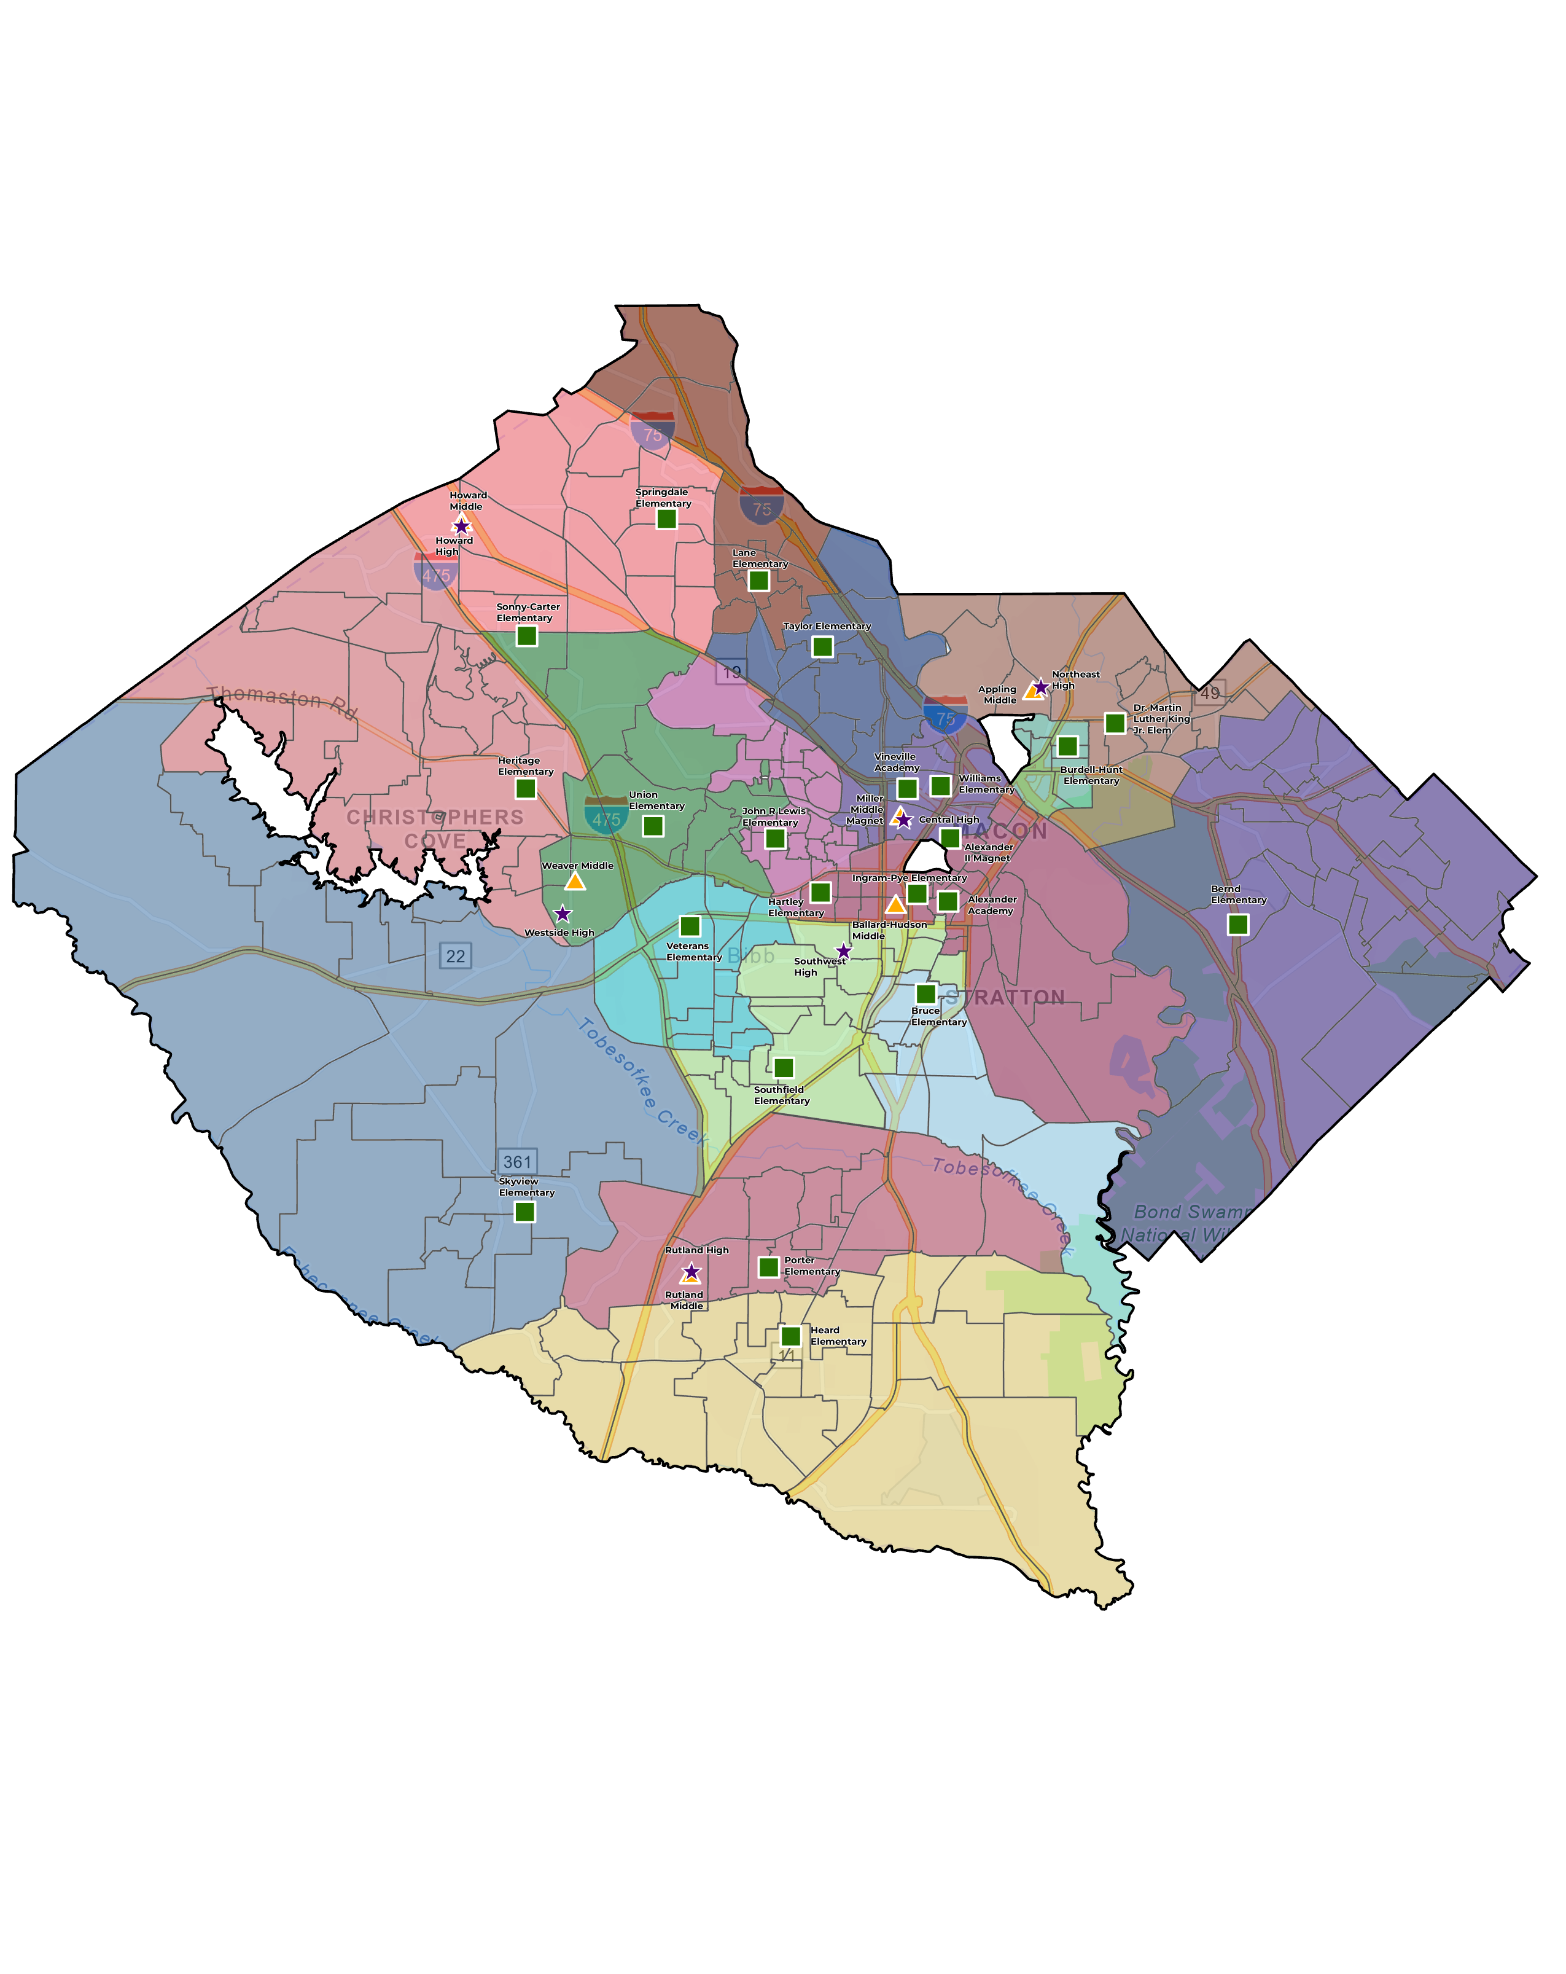
OPTION 1 - ELEMENTARY
Carter ES to Springdale ES
Carter ES to Heritage ES
Carter ES to Union ES
Option 1 closes Carter ES & Hartley ES
Carter ES students are distributed between Heritage, Springdale, Union, and JR Lewis
Areas of JR Lewis also moved to Williams
Hartley ES students are distributed between Ingram and Southfield
Areas of Ingram ES also moved to Southfield
Carter ES to JR Lewis ES
JR Lewis ES to Williams ES
Hartley ES to Ingram ES
Hartley ES and Ingram ES to
Southfield ES

Slide 14
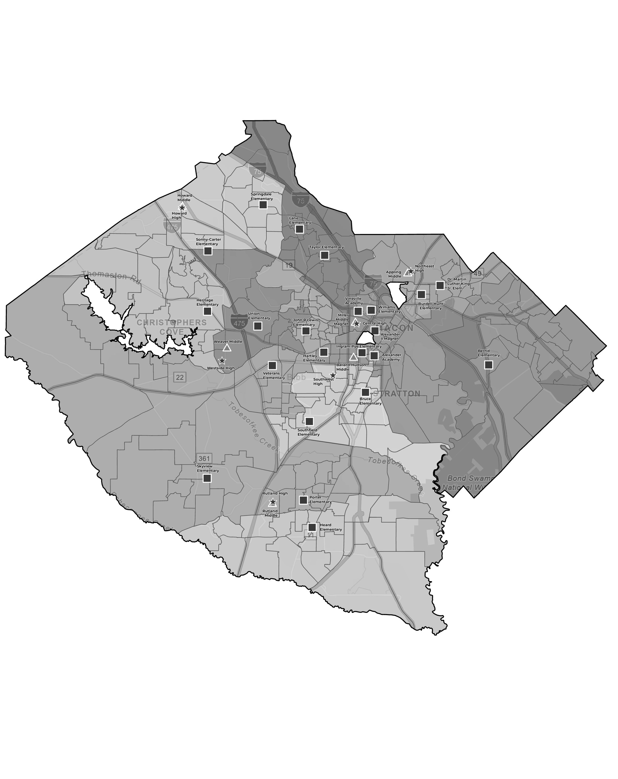
OPTION 1 - ELEMENTARY
Carter ES to Springdale ES
Carter ES to Heritage ES
Carter ES to Union ES
Option 1 closes Carter ES & Hartley ES
Carter ES students are distributed between Heritage, Springdale, Union, and JR Lewis
Hartley ES students are distributed between Ingram and Southfield
Areas of JR Lewis also moved to Williams
Carter ES to JR Lewis ES
JR Lewis ES to Williams ES
Hartley ES to Ingram ES
Hartley ES and Ingram ES to
Southfield ES

Slide 15
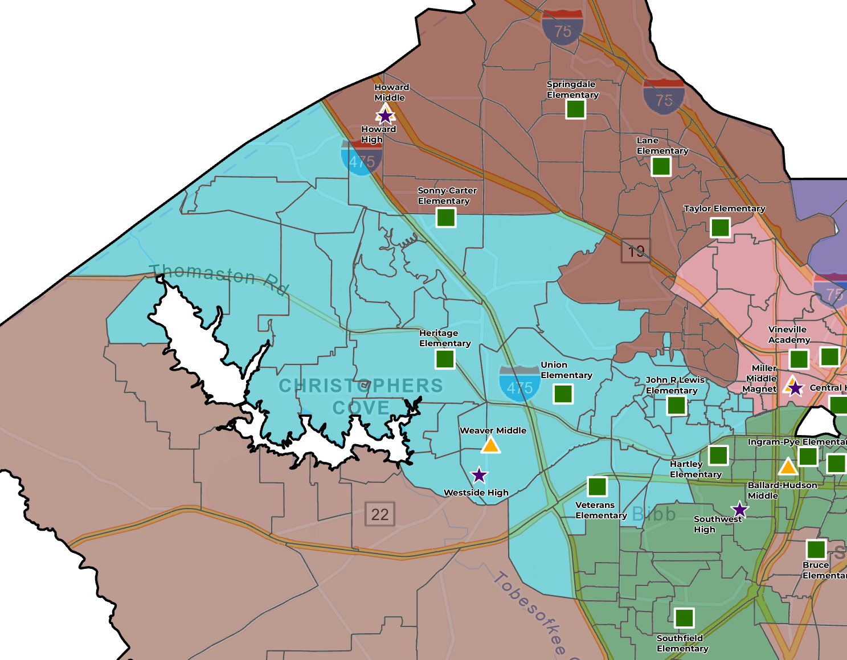
OPTION 1 – MIDDLE
Howard MS to Weaver MS
Areas of Carter ES that move to Heritage ES and Union ES also move to Weaver MS to keep feeder patterns

Slide 16
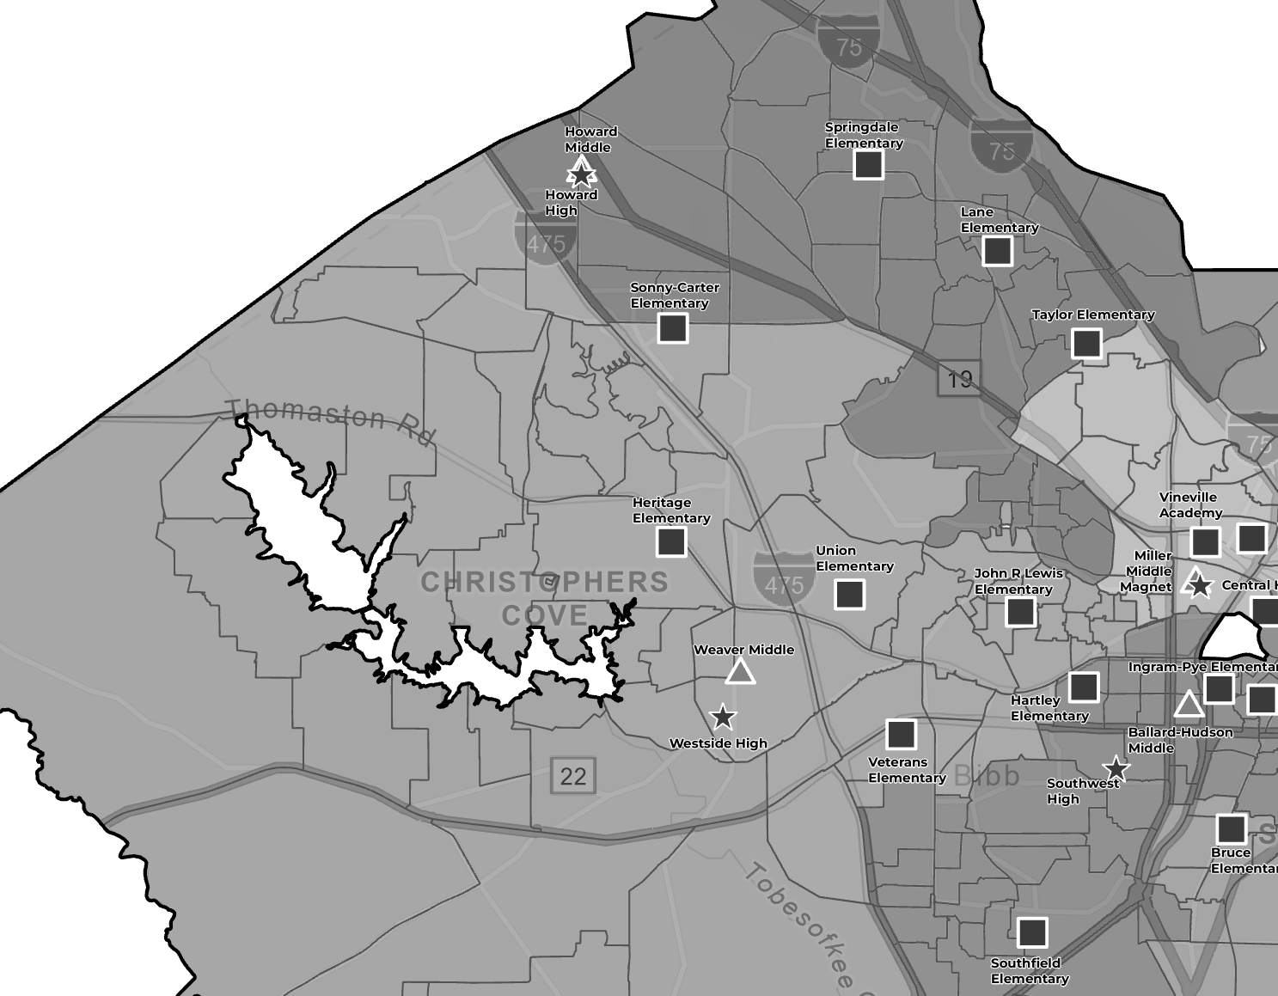
OPTION 1 – MIDDLE
Howard MS to Weaver MS
Areas of Carter ES that move to Heritage ES and Union ES also move to Weaver MS to keep feeder patterns

Slide 17
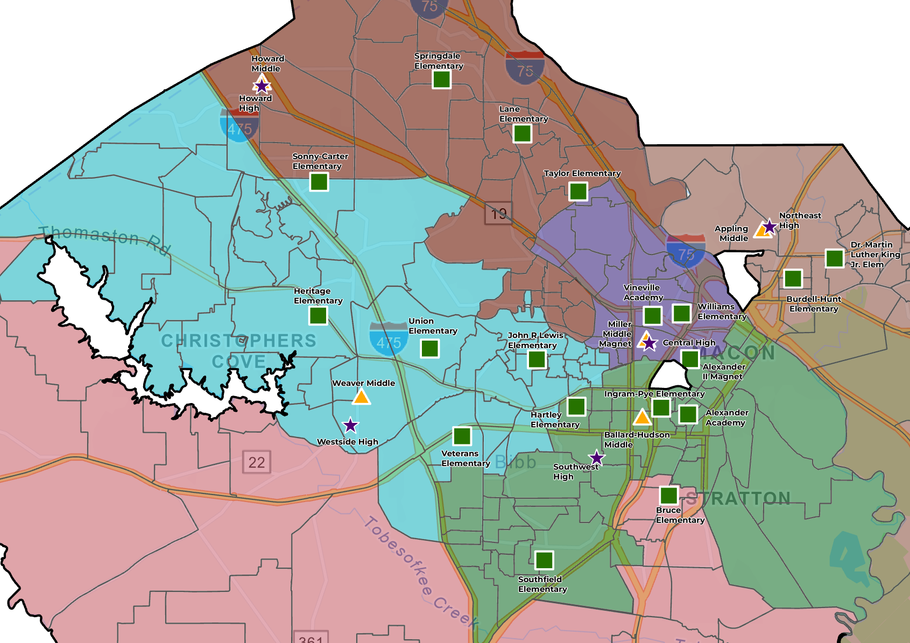
OPTION 1 – HIGH
Howard HS to Westside HS
Areas of Carter ES that move to Heritage ES and Union ES also move to Westside HS to keep feeder patterns
Area of Ingram that feeds Central HS moves to Southwest HS for improved feeder patterns
Central HS to Southwest HS

Slide 18
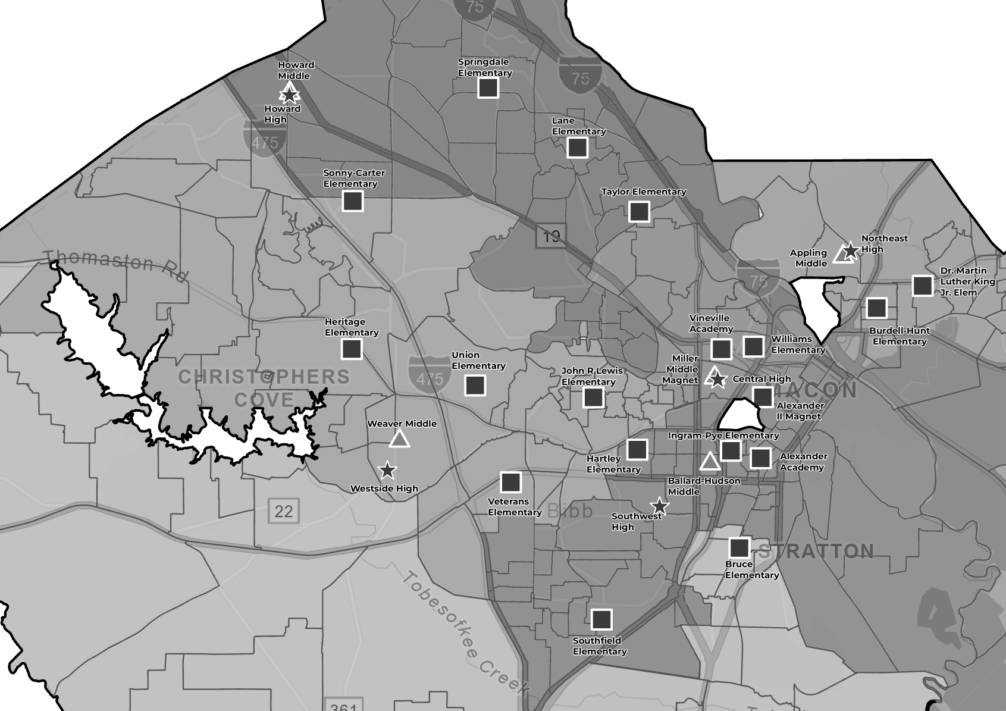
OPTION 1 – HIGH
Howard HS to Westside HS
Areas of Carter ES that move to Heritage ES and Union ES also move to Westside HS to keep feeder patterns
Area of Ingram that feeds Central HS moves to Southwest HS for improved feeder patterns
Central HS to Southwest HS

Slide 19
OPTION 1 – SUMMARY
  Benefits
  Reduces number of zoned elementary schools below 450 (K-5) from 9 to 6
  District-wide utilization at zoned elementary schools increases to 83.8%
  Howard MS no longer over 100% utilized
  Improvement to feeder patterns
    No small splits
    All middle schools feed 100% to 1 high school
K-5 enrollment below 450
  Challenges
  Students impacted:
    878 ES, 83 MS, 241 HS
  Increases Springdale ES to 100% utilization
  Reduced utilization at Central HS to allow all middles to feed 100% to one high school

Slide 20
OPTION 1 – SUMMARY
  JR Lewis no longer splits to three middle schools
  All middle schools feed 100% to one high school

Slide 21
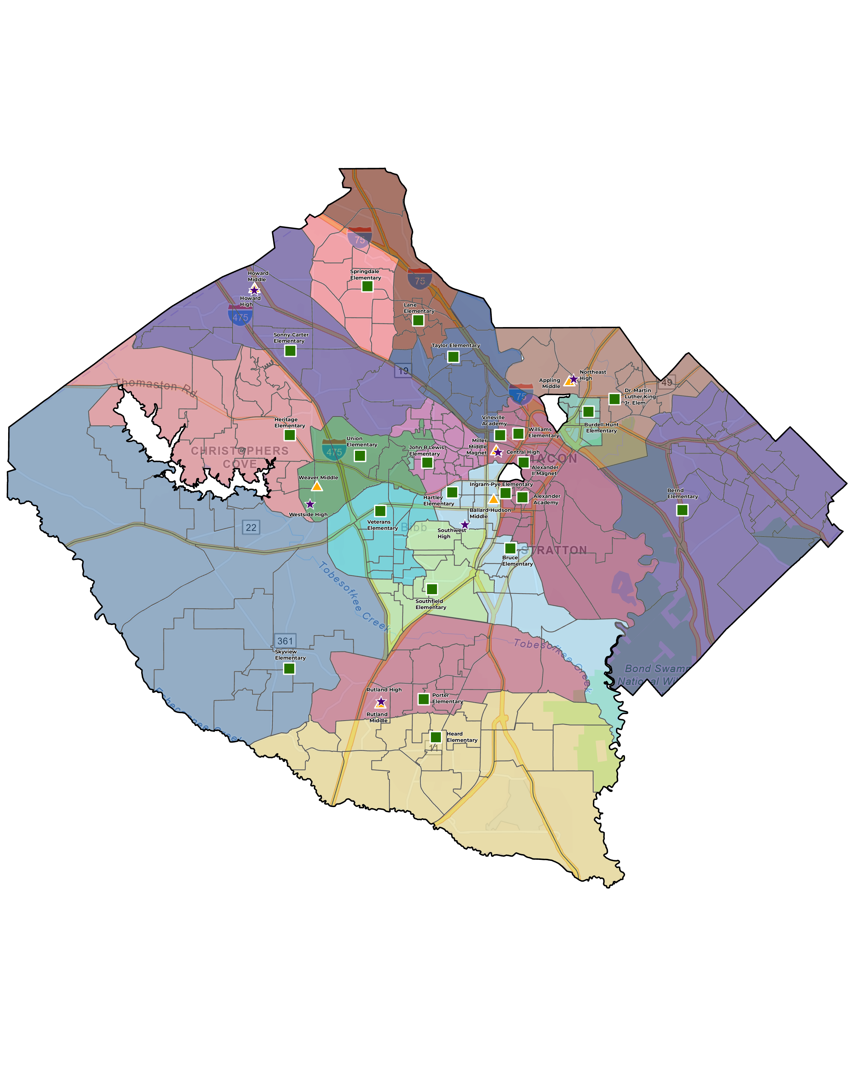
OPTION 2 - ELEMENTARY
Carter ES to Springdale ES
Carter ES to Heritage ES
Carter ES to Union ES
Option 2 closes Carter ES
Carter ES students are distributed between Springdale, Heritage, JR Lewis and Union ES
Area of JR Lewis moves to Williams ES
Carter ES to JR Lewis ES
JR Lewis ES to Williams ES

Slide 22

OPTION 2 - ELEMENTARY
Carter ES to Springdale ES
Carter ES to Heritage ES
Carter ES to Union ES
Option 2 closes Carter ES
Carter ES students are distributed between Springdale, Heritage, JR Lewis and Union ES
Area of JR Lewis moves to Williams ES
Carter ES to JR Lewis ES
JR Lewis ES to Williams ES

Slide 23
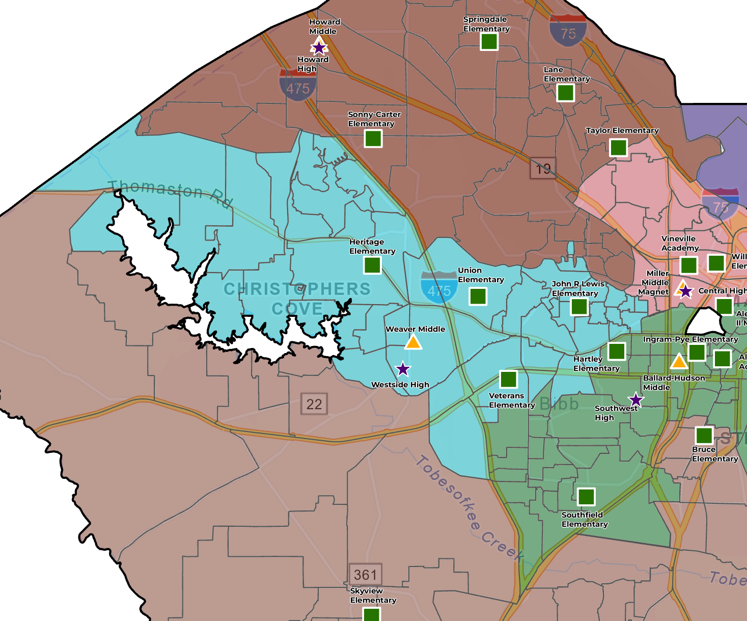
OPTION 2 – MIDDLE
Howard MS to Weaver MS
Area of Carter in Howard MS moves to Weaver MS for improved feeder patterns

Slide 24
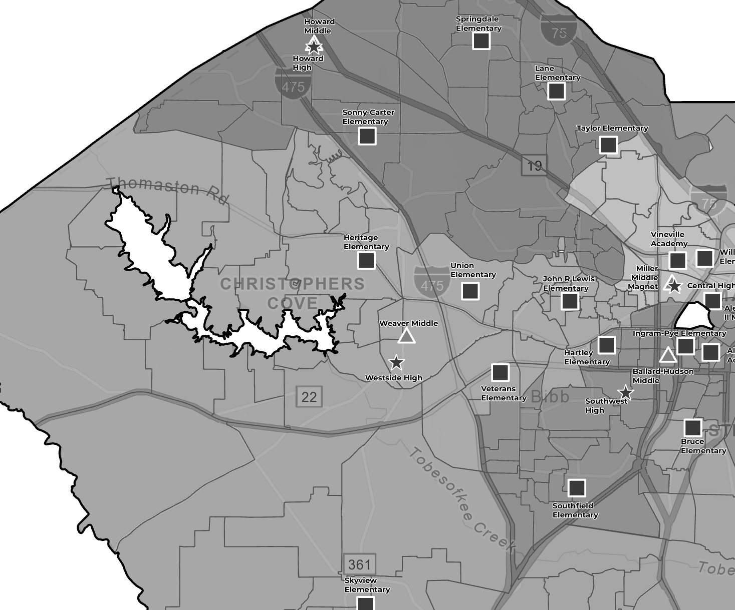
OPTION 2 – MIDDLE
Howard MS to Weaver MS
Area of Carter in Howard MS moves to Weaver MS for improved feeder patterns

Slide 25
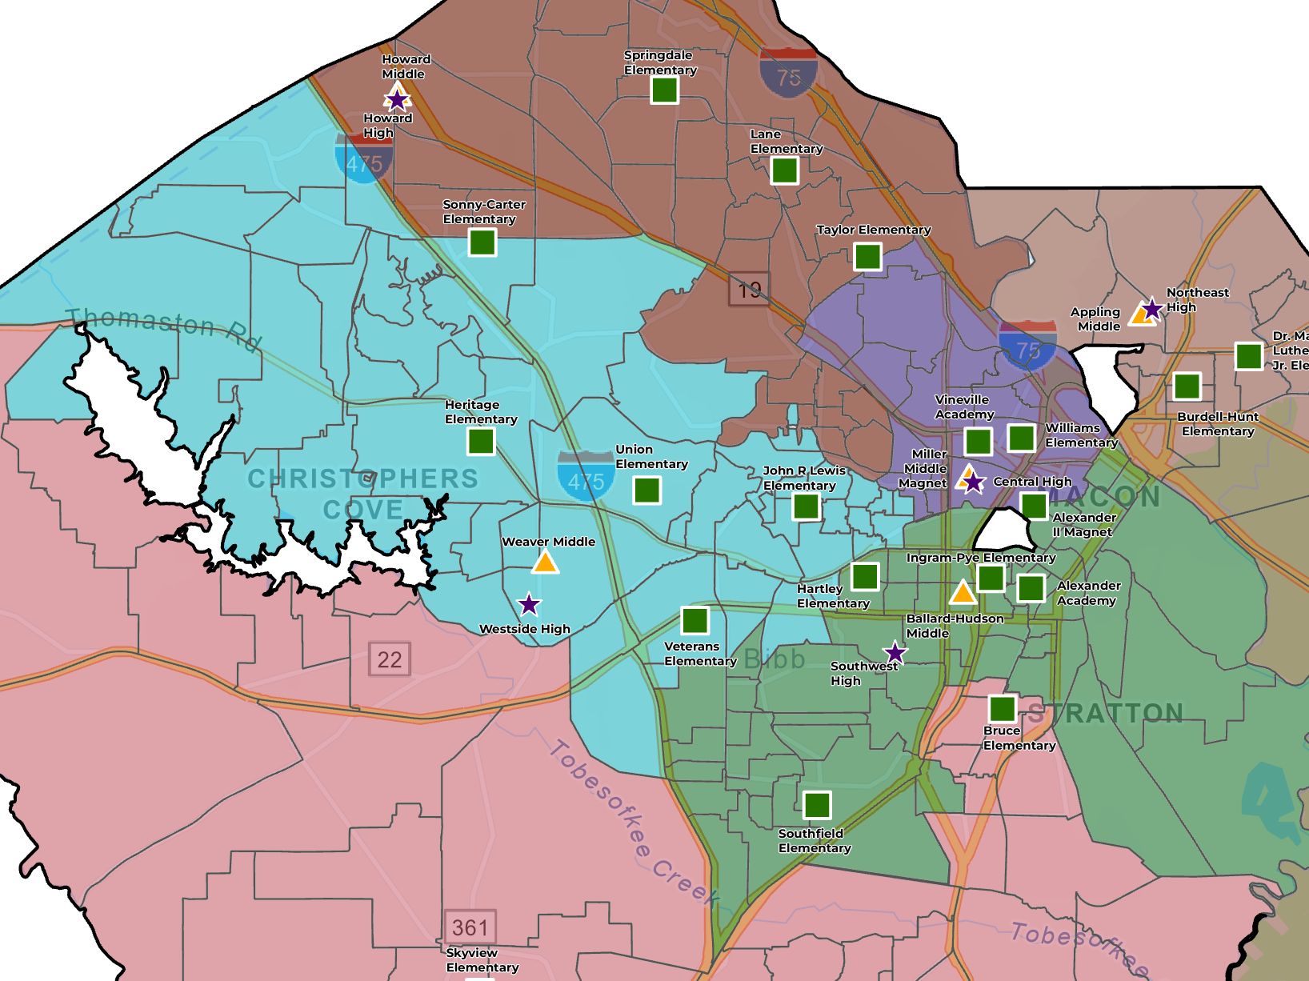
OPTION 2 – HIGH
Howard HS to Westside HS
Area of Carter in Howard HS moves to Westside HS for improved feeder patterns
Area of Ingram that feeds Central HS moves to Southwest HS for improved feeder patterns
Central HS to Southwest HS

Slide 26
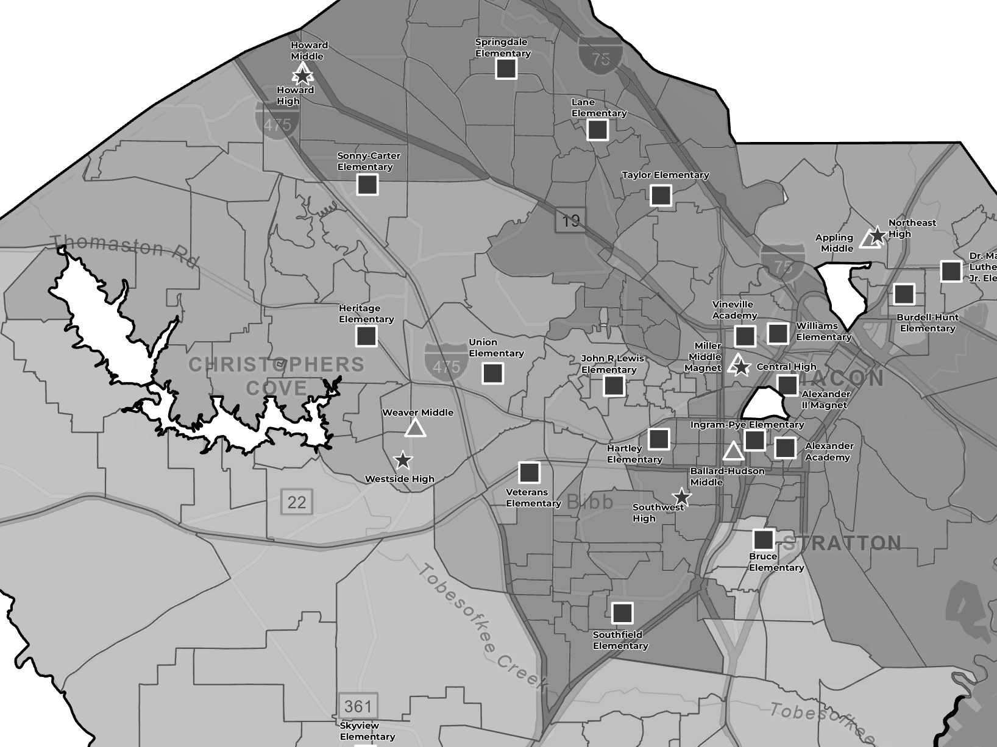
OPTION 2 – HIGH
Howard HS to Westside HS
Area of Carter in Howard HS moves to Westside HS for improved feeder patterns
Area of Ingram that feeds Central HS moves to Southwest HS for improved feeder patterns
Central HS to Southwest HS

Slide 27
OPTION 2 – SUMMARY
  Benefits
  Reduces number of zoned elementary schools below 450 (K-5) from 9 to 8
  District-wide utilization at zoned elementary schools increases to 80.1%
  Improvement to feeder patterns
    No small splits
    All middle schools feed 100% to 1 high school
  Challenges
  Students impacted:
    513 ES, 83 MS, 241 HS
  Increases Springdale ES to 100% utilization
  Only 1 additional school (Union) above 450 enrollment
  Reduced utilization at Central HS to allow all middles to feed 100% to one high school
K-5 enrollment below 450

Slide 28
OPTION 2 – SUMMARY
  JR Lewis no longer splits to three middle schools
  All middle schools feed 100% to one high school

Slide 29
INDEPENDENT OPTION (Discontinue VIP)
This is independent of option 1 or 2; it can be combined, but options 1 and 2 are not dependent on VIP closing.
Because the program draws students Districtwide, discontinuing the program does not have a large impact should those students go back to their attendance boundary school.
VIP Enrollment by Boundary
Appling Middle | 7
Ballard-Hudson Middle | 4
Howard Middle | 10
Miller Magnet Middle | 4
Rutland Middle | 11
Weaver Middle | 6
Central High | 28
Howard High | 35
Northeast High | 39
Rutland High | 29
Southwest High | 28
Westside High | 42
HPMLEADERSHIP.COM

Slide 30
INDEPENDENT OPTION (Rationale)
Sustains a high-quality virtual learning option through a more efficient delivery model – in school academies (ISA).
Aligns resources with student enrollment and long-term program sustainability.
Expands student access to academic, extracurricular, and support services.
Reduces duplication of virtual services and improve operational efficiency.
Strengthens districtwide coordination of virtual learning opportunities.
Ensures responsible stewardship of district resources.
Aligns programming with the district's strategic and operational priorities.
Creates a scalable model that can better serve future student needs.
HPMLEADERSHIP.COM

Slide 31
IMPACTS (ALL Options)
 | Option 1 (Carter & Hartley Consolidate) | Option 2 (Carter Consolidates) | Independent Option (VIP)
Human Resources | Reduces staffing and operational costs (Approximately $2M - $3M) by eliminating administrative and support staff roles. | Reduces staffing and operational costs (Approximately $1M - $1.5M) by eliminating administrative and support staff roles. | Reduction of secondary school administrations (Approximately $350K - $500K) per year in savings.
Facilities | Avoids the renovation of Carter ES. (Approx. $10M) | Avoids the renovation of Carter ES. (Approx. $10M) | Opens up office space at Martin-Whitley Educational Complex.
Teaching and Learning | Increased enrollment at: Heritage, Ingram, J.R. Lewis, Southfield, Springdale, Union, and Williams. | Increased enrollment at: Heritage, JR Lewis, Springdale, Union, and WIlliams. | Increased enrollment at middle and high schools Districtwide Curriculum savings (Edgenuity Program) (Approximately $450K).
Transportation | Closing Carter has a negligible impact on transportation costs (No additional drivers needed) Closing Hartley may result in 5 additional routes ($50K increase per route) | Closing Carter has a negligible impact on transportation costs. | Due to the low number of students, distributed across several schools, it is unlikely that additional transportation routes would be needed.
Total Cost Avoidance | $1.75-2.75M Annually (Net avoidance including increased transportation cost) $10M One-time | $1-1.5M Annually $10M One-time | $800K-950K Annually

Slide 32
NEXT STEPS
Public engagement opportunities will be provided prior to any Board action on consolidation and boundary change recommendations.
A community feedback survey, including a school locator tool, will be launched to collect input on proposed consolidation and boundary changes.
Facility condition assessments will be completed for schools impacted by the proposed scenarios.
HPMLEADERSHIP.COM

Slide 33

THANK YOU

