Slide 1
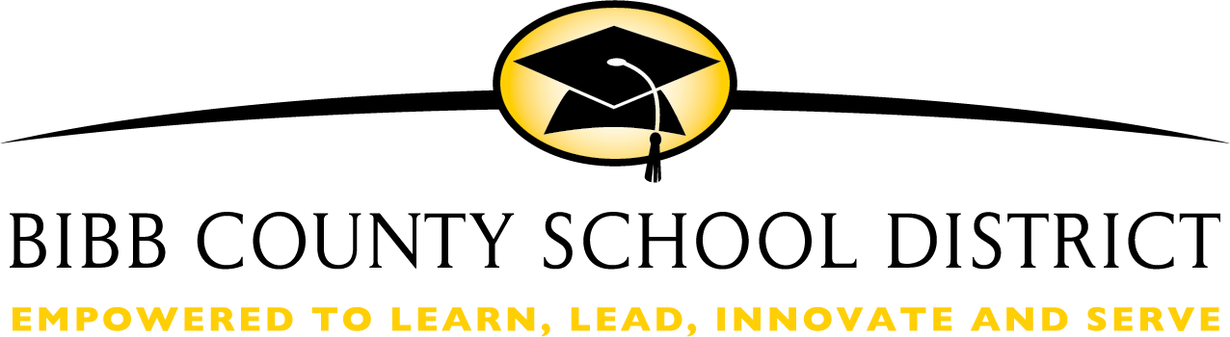
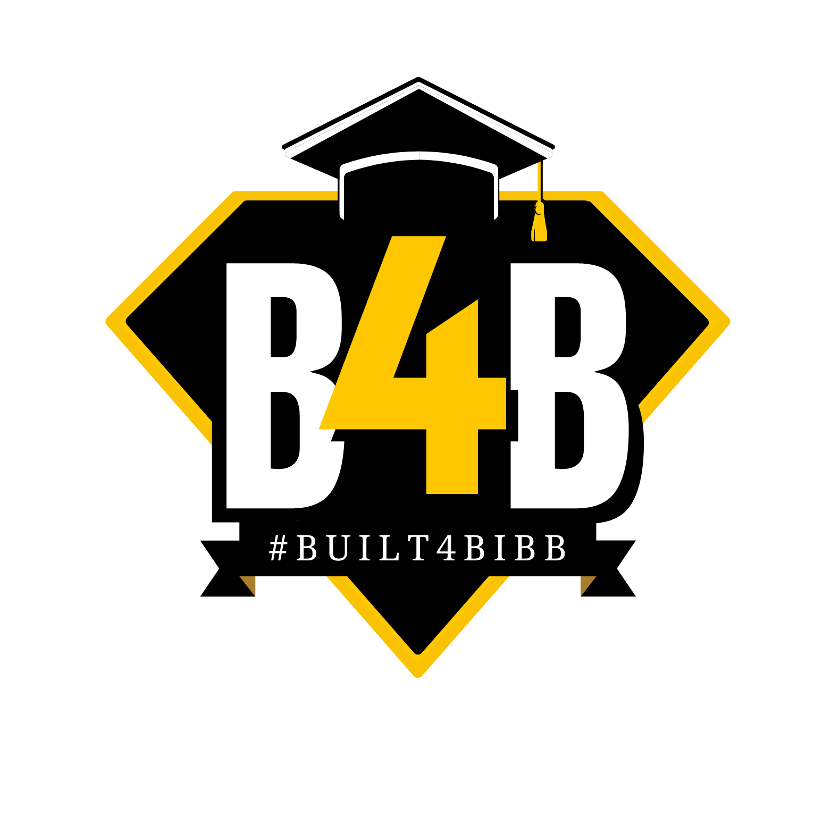
Tentative Adoption
of Millage Rate
FY 2027, Calendar Year 2026
Eric Bush
Chief Financial Officer
Dr. Dan A. Sims
Superintendent
08/20/2026

Slide 2

OUR MISSION
The Bibb County School District maximizes student achievement and social-emotional well-being by building a sense of community in safe, equitable learning environments.
OUR VISION
Students are empowered to learn, lead, innovate and serve as productive and caring citizens within their chosen paths of success.
Notes:
We look forward to presenting you information for this tentative budget adoption that aligns with fulfilling our mission and vision for all our students. We recognize the importance and the intentionality of this mission and vision that drives our entire strategic plan and hope to align with your values as we prepare for the upcoming year.

Slide 3

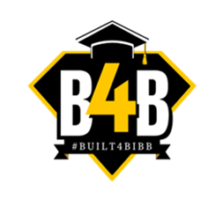
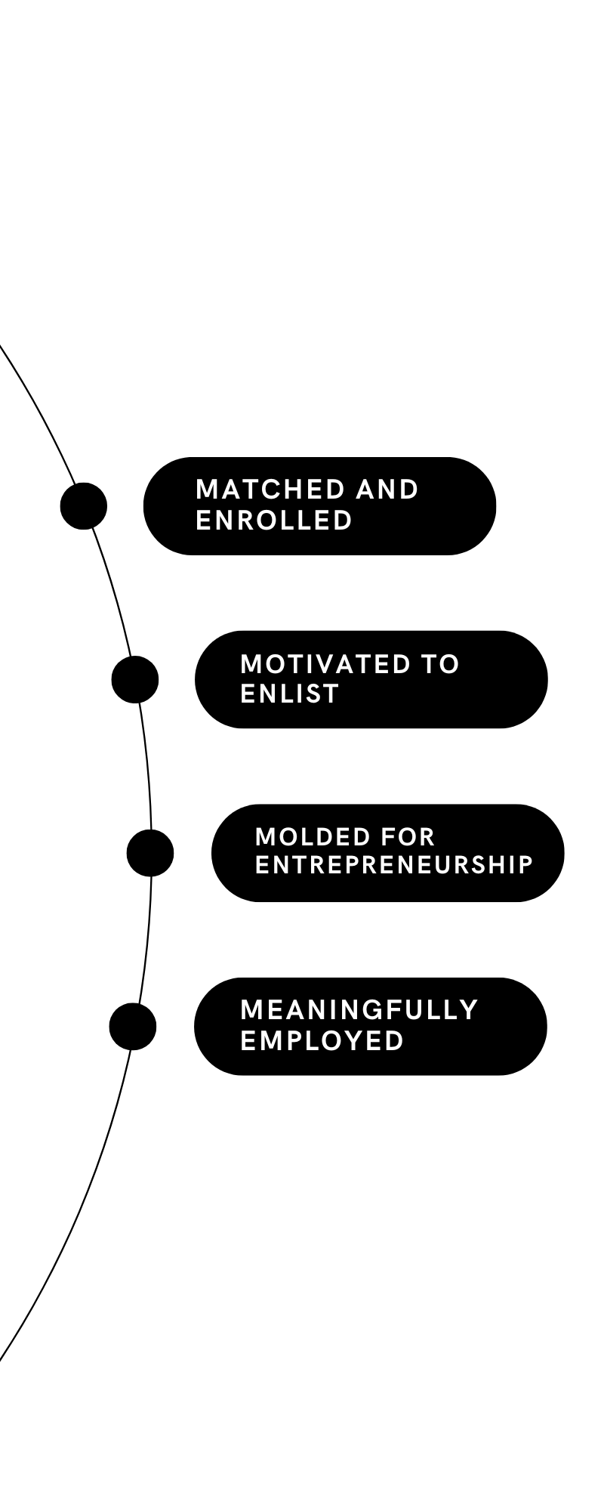
OUR GUIDING PRINCIPLES
OUR GOALS
LEARNER
OUTCOMES
Student Achievement
Staff Effectiveness
Stakeholder Engagement
Each student
will graduate empowered to make a well-informed decision about their next step. They will learn about themselves as they engage in rigorous content and gain exposure through personalized learning experiences, thereby enlightening them to choose their most meaningful pathway.
Personalized Learning
Collaboration
Engagement
Safety
Effective Leadership

Slide 4
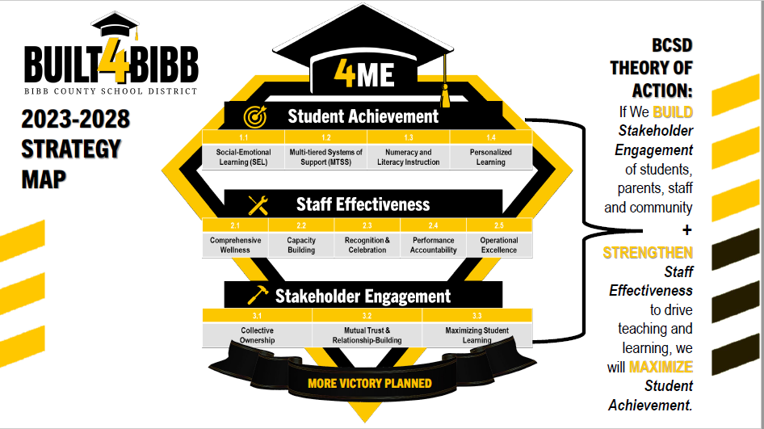

Slide 5
AGENDA
Overview
The purpose of this presentation is to present the FY 2027 (CY 2026) preliminary Tax digest information and other supporting data for the tentative millage rate adoption, public hearings, and final millage rate adoption.
Roadmap
Each year we receive a preliminary tax digest from the tax commission, followed by the final tax digest.
The information presented is based from the preliminary tax digest received June 16, 2026. Final tax digest information is scheduled to be released by August 11,2026. The digest was not received before this meeting, therefore we will be relying on the preliminary digest to inform rate decisions.
Takeaways
The information in this presentation is to provide insight into the millage rate data for CY 2026, FY 2027, and guide decision making in advance of the August 20, 2026 tentative adoption.

Slide 6
C
CY 2026 (FY 2027)
Tax Digest Overview
Tax Digest Received 8/14/2026

Slide 7
Terminology
“Roll-back rate” means the previous year’s millage rate minus the millage equivalent of the total net assessed value added by reassessments.
(CY 2026 Preliminary Roll-back rate = 14.674–(1.252) = 13.422)
“Mill” means one one-thousandth of a United States dollar.
(BCSD Preliminary value of one mill for CY 2026 is $6,972,015)
“Millage rate” means the levy, in mills, which is established by the governing authority (Bibb County Board of Education) for purposes of financing, in whole or in part, the taxing jurisdiction’s (BCSD) expenses for its fiscal year.
Millage Equivalent” means the number of mills which would result when the total net assessed value added by reassessments is divided by the certified tax digest and the result is multiplied by the previous year’s millage rate. (millage equivalent = TBD)
Notes:
Dr. Sims

Slide 8
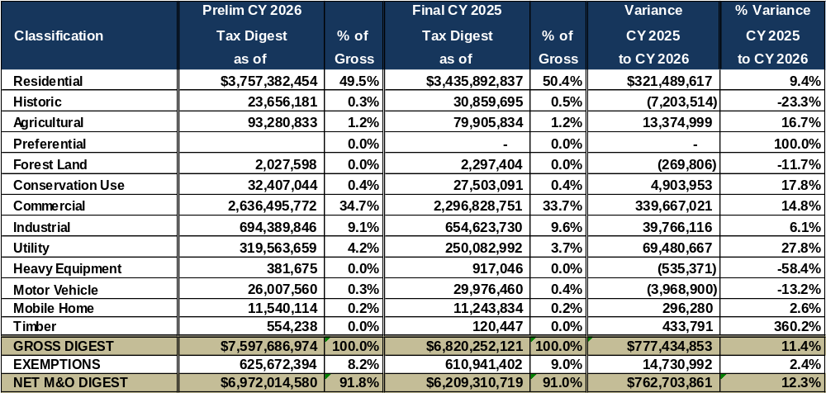
Comparative Tax Digest Schedule Preliminary CY 2026 vs. Final CY 2025
Notes:
Dr. Sims

Slide 9
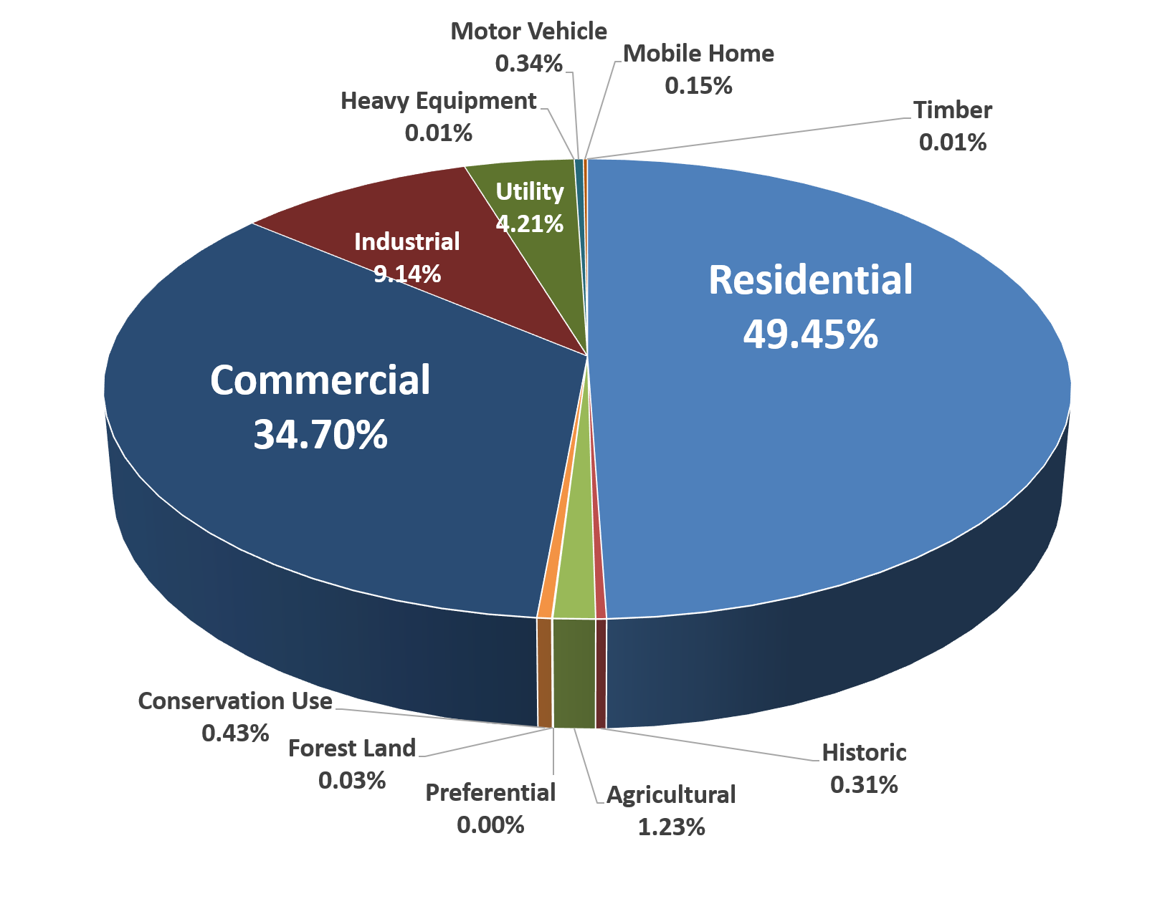
CY 2026 Preliminary Tax Digest by Category
Notes:
Dr. Sims

Slide 10
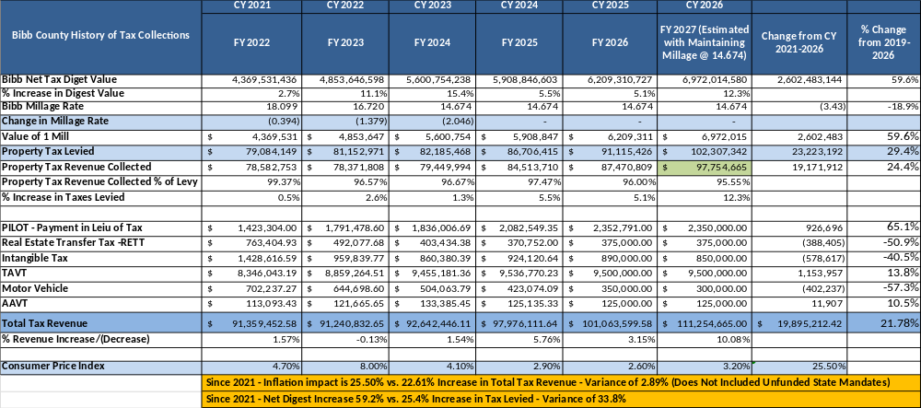
History of Bibb County School District Tax Revenue CY 2019 – CY 2026
Slide 10 shows the history of actual tax collections from FY 2022 to 2026, and projections for FY 2027 using the current millage rate of 14.674.
Notes:
Dr. Sims

Slide 11
CCY 2026 (FY 2027)
Preliminary Outlook for Millage Rate Decisions
Millage Rate Impact on
FY 2026 Budget and Beyond

Slide 12
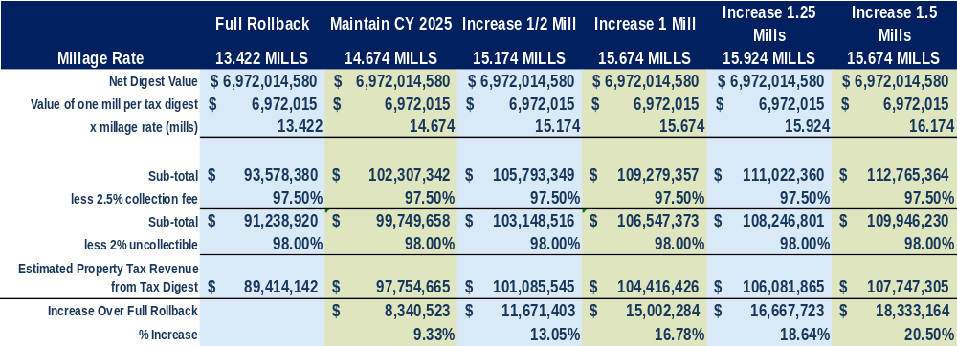
FY 2027 Tax Revenue per Millage Rate Option
This slide shows the basis used throughout the presentation to estimated net tax revenue per millage rate option. The net amount equals gross tax minus fees for collections and uncollectible taxes.
Notes:
Dr. Sims

Slide 13
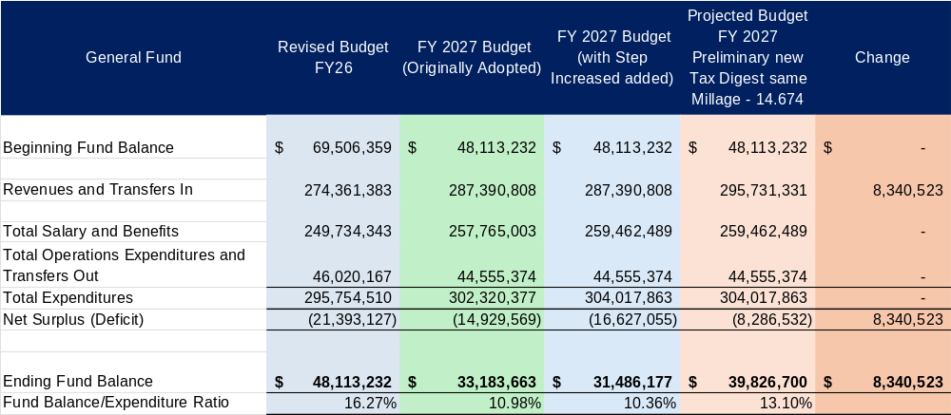
FY 2027 Overall Budget Impact (Maintaining the Millage at 14.674)
Notes:
Dr. Sims

Slide 14
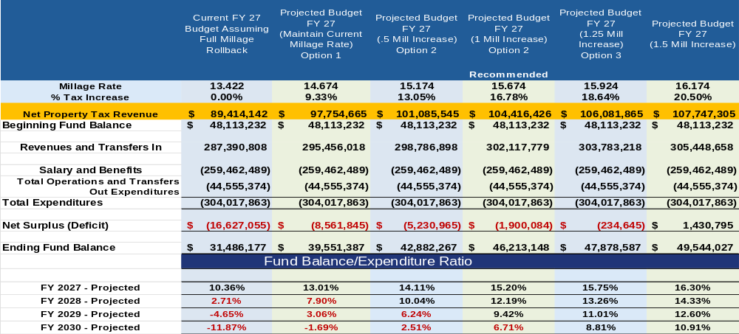
Trends with Maintaining CY 2025 Millage Rate - Trend Projected Using Approved Budget Trends
Slide 14 illustrates the change in Revenues, Net Surplus (Deficit), Ending Fund Balance, for millage rate options. At the bottom, projected Fund Balance to Expenditure Ratios for current year plus three future years is show to illustrate financial health of a district. State law requires school districts maintain a minimum of 8% and a maximum of 25% fund balance to expense ratio.
Notes:
Dr. Sims

Slide 15
Assumptions for Trends
A decrease of $2,000,000 in QBE revenue in 2028 and beyond, due to declining enrollment.
An increase in expense in 2028 and beyond of $4,000,000 to account for adding the book order back in.
An increase in revenue and expense equal to 2% to account for inflation in both directions.
No assumptions for school rezoning or consolidation have been factored into the charts below.
Notes:
Dr. Sims

Slide 16
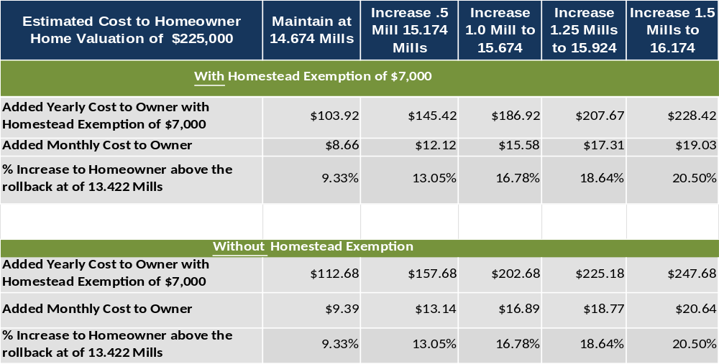
Estimated Cost to Homeowners
Notes:
Dr. Sims

Slide 17
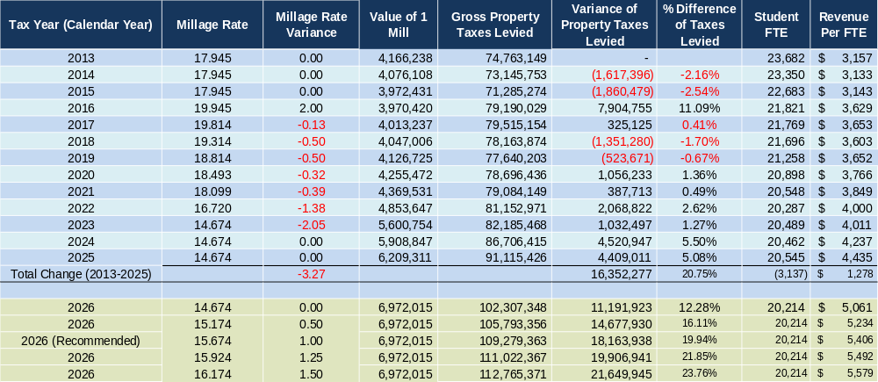
Bibb County Millage Rate and History of Taxes Levied

Slide 18
Considerations– (FY27)
Setting the Budget and Millage Rate
  A primary function of the Board of Education is to set a millage rate and budget that provides needs of the district to ensure financial feasibility as well as sustainability for the future.
  We can accomplish this by responding accordingly to cost increases, especially mandated increase from the state in the areas of salary and benefit cost.
Maintaining a proper Fund Balance
  State law requires each LEA should maintain a fund balance no lower than 8% of expenditures, and no higher than 25%.
  We recommend a minimum fund balance of $60 million, or approximately 20% fund balance to expense ratio.
  A $60 million fund balance provides approximately 75 days of cash on hand, or 2.5 months of free cash flow and would greatly reduce the need for a TAN or tax anticipation note in future years.
  This would provide to the cash needs to support all operations including state and federal grants, considering we pay for these expenditures 1-3 months in advance of reimbursement.
Fluctuating Equalization Grant Revenue
  Bibbs Equalization Grant allocation has experienced high fluctuations in the past few years, increasing and decreasing $10 million in the past two years.
  Consideration to provide adequate local funding must be given in order to reduce the risk of these fluctuations
Notes:
These are the tactical actions we can begin executing in FY27. They address immediate priorities and generate near-term results while we build out the longer-term framework.
First, Efficiency Studies. We are launching instructional efficiency studies designed to identify cost savings and streamline the services we provide to students and schools. The goal is straightforward: use hard data from these audits to align our staffing ratios and resource allocation to actual enrollment figures so that every dollar we spend directly supports student outcomes. We will also implement the attrition position evaluation process from Phase 4 of our operational efficiency study. That means when positions become vacant through attrition, we will evaluate each one individually to determine whether to continue, consolidate responsibilities, or eliminate the role entirely. This is a disciplined, data-driven approach to right-sizing our workforce without disruptive layoffs.
Second, Revenue and Expenditure Alignment. This administration will be proactive rather than reactive. We will anticipate future unfunded mandates and district expenditures before they arrive, so that we bring budget and millage recommendations to this board that are fully aligned with the district’s actual needs. No surprises — just transparent, forward-looking fiscal planning.
Third, Supplemental Pay Restructuring. We are reviewing and revising supplemental pay structures across the entire district. The objective is to standardize processes and pay where applicable, ensuring consistency and fairness while also identifying opportunities for savings.
Finally, Rezoning, Redistricting, and School Consolidation. Using the outcomes from our efficiency studies and redistricting analysis, we will finalize strategic school rezoning, redistricting, and consolidation scenarios. The timeline is clear: board decision-making in FY27, with implementation in FY28. The purpose is to redirect savings toward instructional priorities and concentrate resources where they can produce stronger student outcomes. We are also continuing our efforts to reimagine virtual learning offerings as part of this broader realignment.
Those are the near-term tactical actions. Now I want to shift from what we are doing right now to how we are building a sustainable operating model for the future. The next two slides lay out a structured planning-to-implementation framework — first the FY27 planning phase, then how that planning translates into implementation and sustainability starting in FY28.

Slide 19
CCY 2026 (FY 2027)
Surrounding County and Similar Sized District Data Overview
Slides 19 - 24

Slide 20
Surrounding and Like Size District Data
  The following slides are presented to illustrate how Bibb County School District compares to our peers, either locally or as similar sized districts.
  Context of following Slides
  Slide 1 of 6 provided enrollment data, showing many districts are experiencing a declining enrollment
  Slide 2 of 6 provides QBE revenue comparisons which can vary by district depending on student body composition and categorical grant allocations, including the state equalization grant.
  Slide 3 of 6 provides Net Tax Digest values for each district
  Slide 4 of 6 provides Tax Revenue per district.
  Slide 5 of 6 provides additional data on Tax Revenue per district
  Slide 6 of 6 provides a summary data on the mixture of QBE and Tax Revenue per district.
  Considerations
  The following data show that Bibb County has much less revenue per student to operate our district than our similar sized and surrounding counties. Most notably, slide 5 of 6 shows that the increase in revenue per student from 2021 to 2026, Bibb is receiving $596 increased local funding per student while most others are receiving $2,000, almost 4 times more.
  This is directly attributed to maintaining a low millage rate and not responding to increase cost pressures appropriately, which directly challenges our ability to be financially stable.
Notes:
These are the tactical actions we can begin executing in FY27. They address immediate priorities and generate near-term results while we build out the longer-term framework.
First, Efficiency Studies. We are launching instructional efficiency studies designed to identify cost savings and streamline the services we provide to students and schools. The goal is straightforward: use hard data from these audits to align our staffing ratios and resource allocation to actual enrollment figures so that every dollar we spend directly supports student outcomes. We will also implement the attrition position evaluation process from Phase 4 of our operational efficiency study. That means when positions become vacant through attrition, we will evaluate each one individually to determine whether to continue, consolidate responsibilities, or eliminate the role entirely. This is a disciplined, data-driven approach to right-sizing our workforce without disruptive layoffs.
Second, Revenue and Expenditure Alignment. This administration will be proactive rather than reactive. We will anticipate future unfunded mandates and district expenditures before they arrive, so that we bring budget and millage recommendations to this board that are fully aligned with the district’s actual needs. No surprises — just transparent, forward-looking fiscal planning.
Third, Supplemental Pay Restructuring. We are reviewing and revising supplemental pay structures across the entire district. The objective is to standardize processes and pay where applicable, ensuring consistency and fairness while also identifying opportunities for savings.
Finally, Rezoning, Redistricting, and School Consolidation. Using the outcomes from our efficiency studies and redistricting analysis, we will finalize strategic school rezoning, redistricting, and consolidation scenarios. The timeline is clear: board decision-making in FY27, with implementation in FY28. The purpose is to redirect savings toward instructional priorities and concentrate resources where they can produce stronger student outcomes. We are also continuing our efforts to reimagine virtual learning offerings as part of this broader realignment.
Those are the near-term tactical actions. Now I want to shift from what we are doing right now to how we are building a sustainable operating model for the future. The next two slides lay out a structured planning-to-implementation framework — first the FY27 planning phase, then how that planning translates into implementation and sustainability starting in FY28.

Slide 21
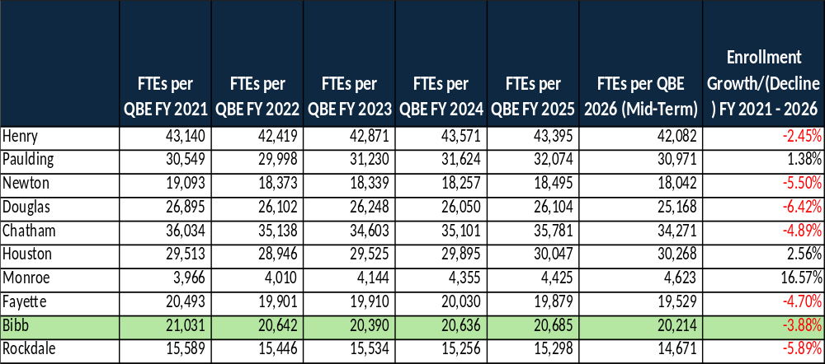
Enrollment Comparisons (Slide 1 of 6)
Notes:
Before I walk you through our specific strategies, I want to take a moment to frame the broader context for why these considerations are so important right now.
Historically, the Bibb County School District has rolled back the millage rate. While that decision provided tax relief to our community, it has had a compounding effect over time. Each rollback limits our ability to capture growth in local tax revenue — revenue that is essential to sustaining and expanding the district’s operations. In practical terms, it means that even as property values have grown, the district has not fully benefited from that growth on the revenue side.
That brings us to where we are today. As we work to align our resources with strategic priorities and ensure the long-term sustainability of this district, we are considering a range of options to optimize efficiency and maximize our impact for students. These options span both medium-term and long-term time horizons, and I want to be transparent with this board about what each of those looks like.
The current financial model is not keeping pace with rising costs in salaries, benefits, maintenance, and unfunded mandates. That is why this administration is taking decisive action. We are conducting a thorough review of how we allocate every dollar, and we will make the difficult but necessary adjustments to protect the quality of education our students and families depend on.
Over the next three slides, I’m going to walk you through our response to this challenge in three parts. First, the medium-term actions we can take right now in FY27 — tactical steps like efficiency studies, pay restructuring, and rezoning analysis that deliver near-term results. Then, I’ll show you the structured planning framework we are building in FY27 across operational efficiency, financial sustainability, and compensation alignment. And finally, how that planning translates into concrete implementation and sustainability efforts starting in FY28 and continuing beyond.
Let’s start with the medium-term strategies.

Slide 22
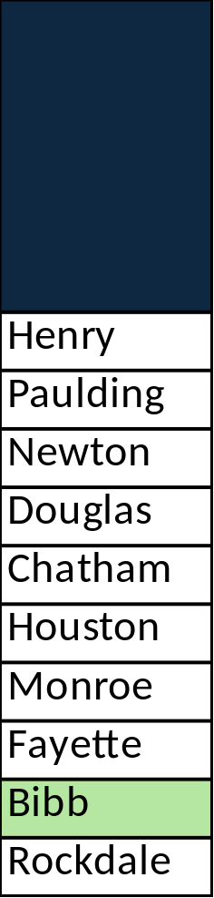
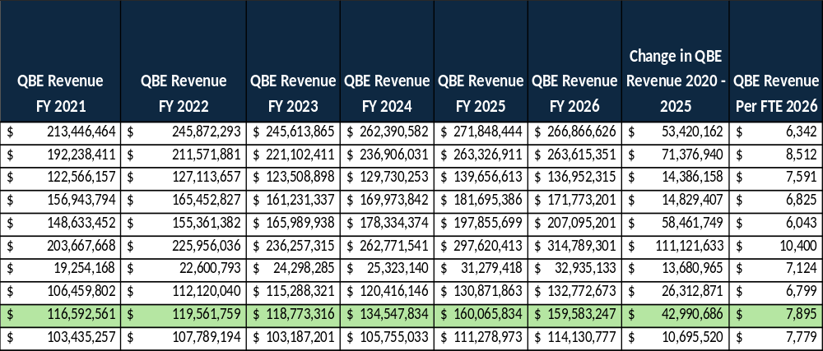
QBE Revenue Comparison (Slide 2 of 6)
QBE revenue varies due to several factors, including enrollment per grade level, student needs, transportation, and various categorical grants including the state equalization grant.
Notes:
Before I walk you through our specific strategies, I want to take a moment to frame the broader context for why these considerations are so important right now.
Historically, the Bibb County School District has rolled back the millage rate. While that decision provided tax relief to our community, it has had a compounding effect over time. Each rollback limits our ability to capture growth in local tax revenue — revenue that is essential to sustaining and expanding the district’s operations. In practical terms, it means that even as property values have grown, the district has not fully benefited from that growth on the revenue side.
That brings us to where we are today. As we work to align our resources with strategic priorities and ensure the long-term sustainability of this district, we are considering a range of options to optimize efficiency and maximize our impact for students. These options span both medium-term and long-term time horizons, and I want to be transparent with this board about what each of those looks like.
The current financial model is not keeping pace with rising costs in salaries, benefits, maintenance, and unfunded mandates. That is why this administration is taking decisive action. We are conducting a thorough review of how we allocate every dollar, and we will make the difficult but necessary adjustments to protect the quality of education our students and families depend on.
Over the next three slides, I’m going to walk you through our response to this challenge in three parts. First, the medium-term actions we can take right now in FY27 — tactical steps like efficiency studies, pay restructuring, and rezoning analysis that deliver near-term results. Then, I’ll show you the structured planning framework we are building in FY27 across operational efficiency, financial sustainability, and compensation alignment. And finally, how that planning translates into concrete implementation and sustainability efforts starting in FY28 and continuing beyond.
Let’s start with the medium-term strategies.

Slide 23
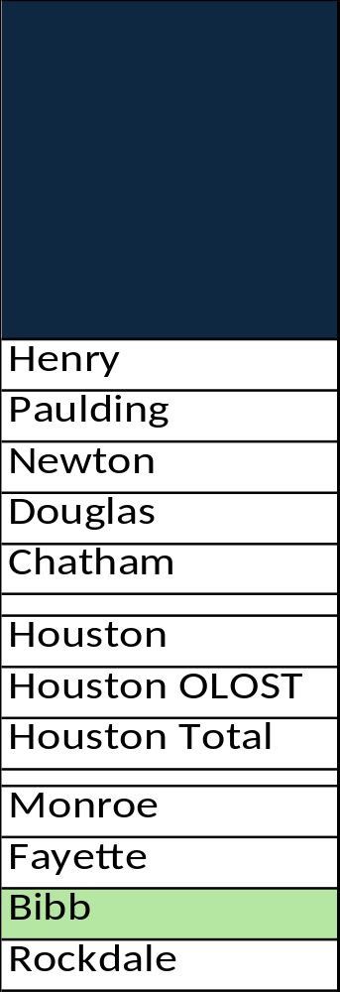
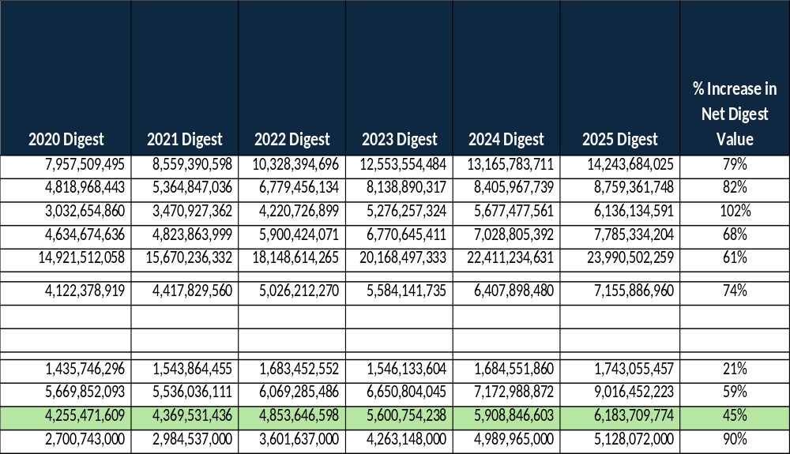
Tax Digest Net Value Comparison (Slide 3 of 6)
Notes:
Before I walk you through our specific strategies, I want to take a moment to frame the broader context for why these considerations are so important right now.
Historically, the Bibb County School District has rolled back the millage rate. While that decision provided tax relief to our community, it has had a compounding effect over time. Each rollback limits our ability to capture growth in local tax revenue — revenue that is essential to sustaining and expanding the district’s operations. In practical terms, it means that even as property values have grown, the district has not fully benefited from that growth on the revenue side.
That brings us to where we are today. As we work to align our resources with strategic priorities and ensure the long-term sustainability of this district, we are considering a range of options to optimize efficiency and maximize our impact for students. These options span both medium-term and long-term time horizons, and I want to be transparent with this board about what each of those looks like.
The current financial model is not keeping pace with rising costs in salaries, benefits, maintenance, and unfunded mandates. That is why this administration is taking decisive action. We are conducting a thorough review of how we allocate every dollar, and we will make the difficult but necessary adjustments to protect the quality of education our students and families depend on.
Over the next three slides, I’m going to walk you through our response to this challenge in three parts. First, the medium-term actions we can take right now in FY27 — tactical steps like efficiency studies, pay restructuring, and rezoning analysis that deliver near-term results. Then, I’ll show you the structured planning framework we are building in FY27 across operational efficiency, financial sustainability, and compensation alignment. And finally, how that planning translates into concrete implementation and sustainability efforts starting in FY28 and continuing beyond.
Let’s start with the medium-term strategies.

Slide 24
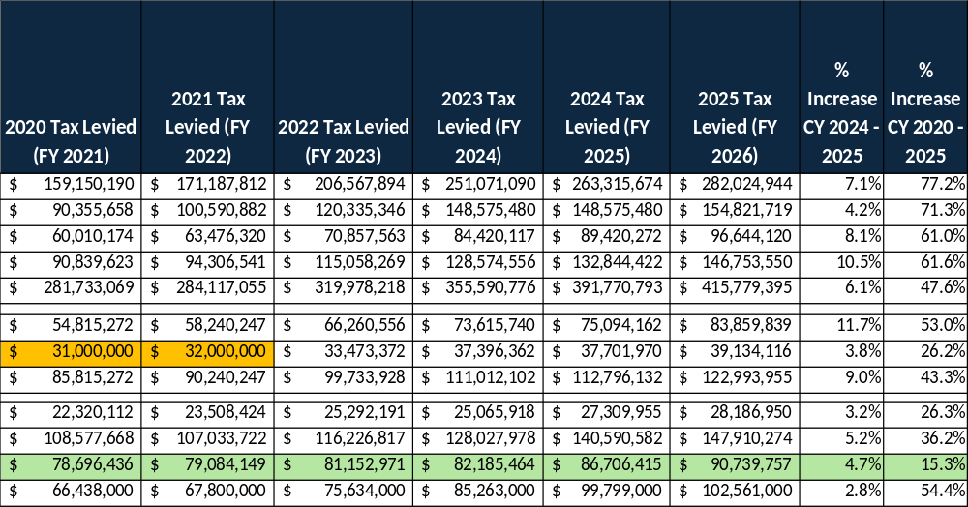
Taxes Levied Comparison (Slide 4 of 6)
Notes:
Before I walk you through our specific strategies, I want to take a moment to frame the broader context for why these considerations are so important right now.
Historically, the Bibb County School District has rolled back the millage rate. While that decision provided tax relief to our community, it has had a compounding effect over time. Each rollback limits our ability to capture growth in local tax revenue — revenue that is essential to sustaining and expanding the district’s operations. In practical terms, it means that even as property values have grown, the district has not fully benefited from that growth on the revenue side.
That brings us to where we are today. As we work to align our resources with strategic priorities and ensure the long-term sustainability of this district, we are considering a range of options to optimize efficiency and maximize our impact for students. These options span both medium-term and long-term time horizons, and I want to be transparent with this board about what each of those looks like.
The current financial model is not keeping pace with rising costs in salaries, benefits, maintenance, and unfunded mandates. That is why this administration is taking decisive action. We are conducting a thorough review of how we allocate every dollar, and we will make the difficult but necessary adjustments to protect the quality of education our students and families depend on.
Over the next three slides, I’m going to walk you through our response to this challenge in three parts. First, the medium-term actions we can take right now in FY27 — tactical steps like efficiency studies, pay restructuring, and rezoning analysis that deliver near-term results. Then, I’ll show you the structured planning framework we are building in FY27 across operational efficiency, financial sustainability, and compensation alignment. And finally, how that planning translates into concrete implementation and sustainability efforts starting in FY28 and continuing beyond.
Let’s start with the medium-term strategies.

Slide 25
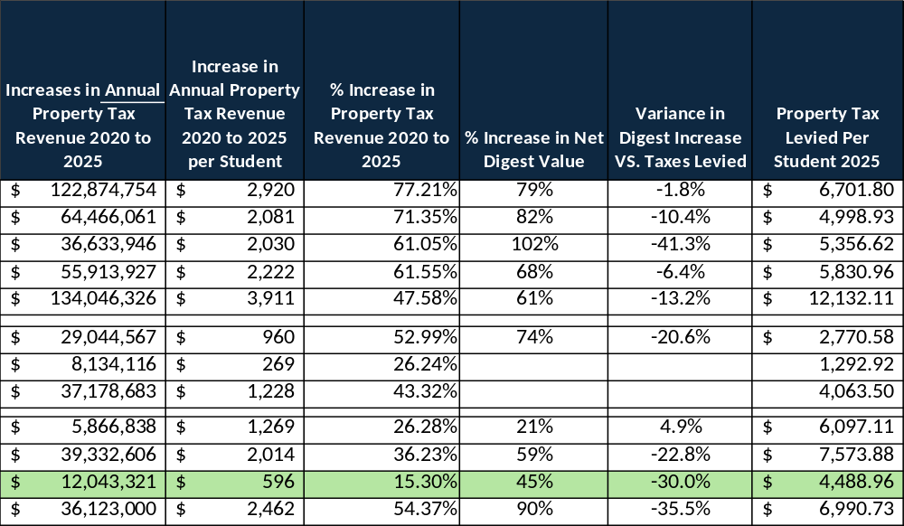
Tax Revenue Summary (Slide 5 of 6)
Notes:
Before I walk you through our specific strategies, I want to take a moment to frame the broader context for why these considerations are so important right now.
Historically, the Bibb County School District has rolled back the millage rate. While that decision provided tax relief to our community, it has had a compounding effect over time. Each rollback limits our ability to capture growth in local tax revenue — revenue that is essential to sustaining and expanding the district’s operations. In practical terms, it means that even as property values have grown, the district has not fully benefited from that growth on the revenue side.
That brings us to where we are today. As we work to align our resources with strategic priorities and ensure the long-term sustainability of this district, we are considering a range of options to optimize efficiency and maximize our impact for students. These options span both medium-term and long-term time horizons, and I want to be transparent with this board about what each of those looks like.
The current financial model is not keeping pace with rising costs in salaries, benefits, maintenance, and unfunded mandates. That is why this administration is taking decisive action. We are conducting a thorough review of how we allocate every dollar, and we will make the difficult but necessary adjustments to protect the quality of education our students and families depend on.
Over the next three slides, I’m going to walk you through our response to this challenge in three parts. First, the medium-term actions we can take right now in FY27 — tactical steps like efficiency studies, pay restructuring, and rezoning analysis that deliver near-term results. Then, I’ll show you the structured planning framework we are building in FY27 across operational efficiency, financial sustainability, and compensation alignment. And finally, how that planning translates into concrete implementation and sustainability efforts starting in FY28 and continuing beyond.
Let’s start with the medium-term strategies.

Slide 26
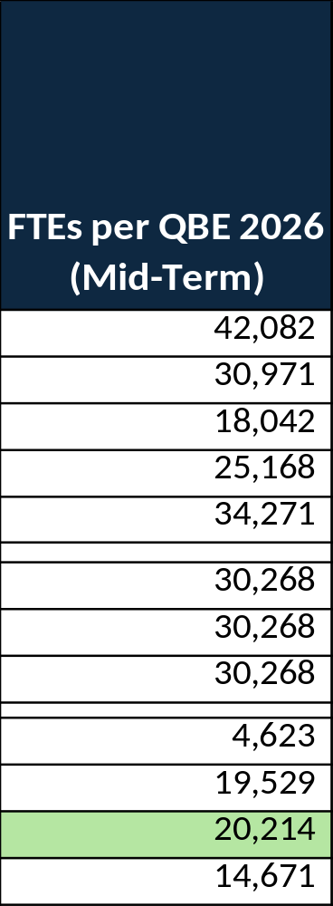
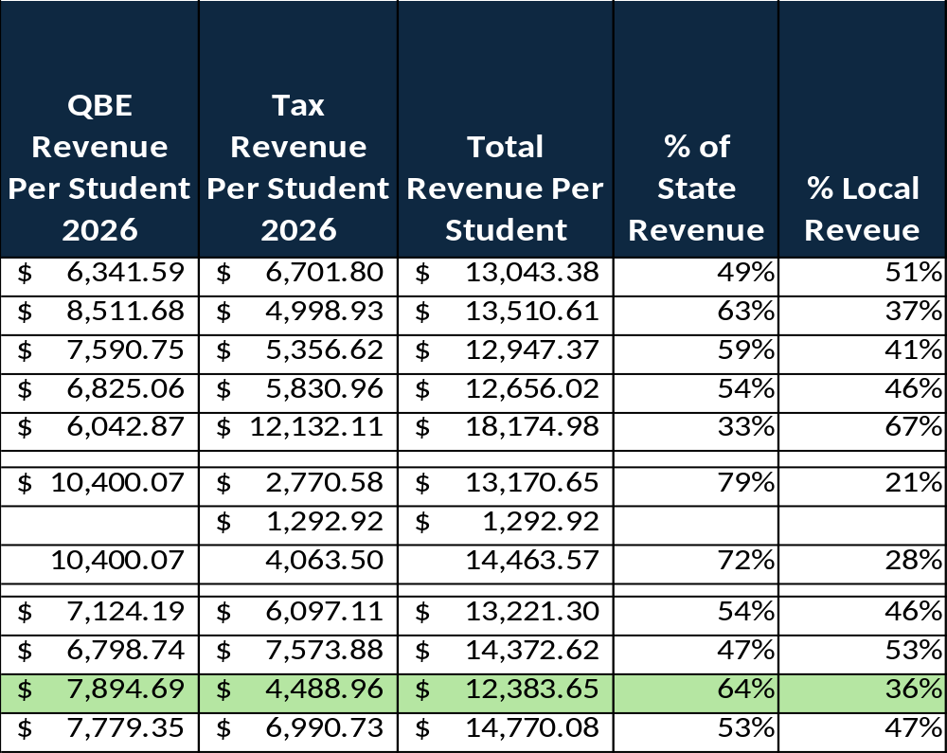
QBE and Property Tax Revenue Summary (Slide 6 of 6)
Notes:
Before I walk you through our specific strategies, I want to take a moment to frame the broader context for why these considerations are so important right now.
Historically, the Bibb County School District has rolled back the millage rate. While that decision provided tax relief to our community, it has had a compounding effect over time. Each rollback limits our ability to capture growth in local tax revenue — revenue that is essential to sustaining and expanding the district’s operations. In practical terms, it means that even as property values have grown, the district has not fully benefited from that growth on the revenue side.
That brings us to where we are today. As we work to align our resources with strategic priorities and ensure the long-term sustainability of this district, we are considering a range of options to optimize efficiency and maximize our impact for students. These options span both medium-term and long-term time horizons, and I want to be transparent with this board about what each of those looks like.
The current financial model is not keeping pace with rising costs in salaries, benefits, maintenance, and unfunded mandates. That is why this administration is taking decisive action. We are conducting a thorough review of how we allocate every dollar, and we will make the difficult but necessary adjustments to protect the quality of education our students and families depend on.
Over the next three slides, I’m going to walk you through our response to this challenge in three parts. First, the medium-term actions we can take right now in FY27 — tactical steps like efficiency studies, pay restructuring, and rezoning analysis that deliver near-term results. Then, I’ll show you the structured planning framework we are building in FY27 across operational efficiency, financial sustainability, and compensation alignment. And finally, how that planning translates into concrete implementation and sustainability efforts starting in FY28 and continuing beyond.
Let’s start with the medium-term strategies.

Slide 27
CCY 2026 (FY 2027)
Mid-Term Strategies and Next Steps

Slide 28
Medium-Term Strategies – (FY27)
Efficiency Studies
  Launch instructional efficiency studies to identify potential cost savings and streamline services provided to students and schools.
  Use efficiency audit findings to align staffing ratios and resource allocation to actual enrollment, ensuring every dollar directly supports student outcomes.
  Implement attrition position evaluation process from Phase 4 of the operational efficiency study to identify positions for continuation, consolidation of responsibilities or elimination.
Revenue/Expenditure Alignment
  Anticipate future unfunded mandates and district expenditures to bring budget and millage recommendations to the board in alignment with the district’s needs.
Supplemental Pay Restructuring
  Review and revise supplemental pay structures across the district and standardize processes and pay where applicable.
Rezoning/Redistricting vs. School Consolidation
  Using efficiency and redistricting outcomes, finalize strategic school rezoning/redistricting & consolidation scenarios for FY27 board decision making and FY28 implementation to redirect savings toward instructional priorities and concentrate resources for stronger student outcomes.
  Continue efforts to reimagine virtual learning offerings.
Notes:
These are the tactical actions we can begin executing in FY27. They address immediate priorities and generate near-term results while we build out the longer-term framework.
First, Efficiency Studies. We are launching instructional efficiency studies designed to identify cost savings and streamline the services we provide to students and schools. The goal is straightforward: use hard data from these audits to align our staffing ratios and resource allocation to actual enrollment figures so that every dollar we spend directly supports student outcomes. We will also implement the attrition position evaluation process from Phase 4 of our operational efficiency study. That means when positions become vacant through attrition, we will evaluate each one individually to determine whether to continue, consolidate responsibilities, or eliminate the role entirely. This is a disciplined, data-driven approach to right-sizing our workforce without disruptive layoffs.
Second, Revenue and Expenditure Alignment. This administration will be proactive rather than reactive. We will anticipate future unfunded mandates and district expenditures before they arrive, so that we bring budget and millage recommendations to this board that are fully aligned with the district’s actual needs. No surprises — just transparent, forward-looking fiscal planning.
Third, Supplemental Pay Restructuring. We are reviewing and revising supplemental pay structures across the entire district. The objective is to standardize processes and pay where applicable, ensuring consistency and fairness while also identifying opportunities for savings.
Finally, Rezoning, Redistricting, and School Consolidation. Using the outcomes from our efficiency studies and redistricting analysis, we will finalize strategic school rezoning, redistricting, and consolidation scenarios. The timeline is clear: board decision-making in FY27, with implementation in FY28. The purpose is to redirect savings toward instructional priorities and concentrate resources where they can produce stronger student outcomes. We are also continuing our efforts to reimagine virtual learning offerings as part of this broader realignment.
Those are the near-term tactical actions. Now I want to shift from what we are doing right now to how we are building a sustainable operating model for the future. The next two slides lay out a structured planning-to-implementation framework — first the FY27 planning phase, then how that planning translates into implementation and sustainability starting in FY28.

Slide 29
NEXT STEPS – BUDGET AND MILLAGE RATE
1. The Board shall adopt a tentative millage rate for the calendar year 2026
2. The tentative millage rate announcement and five-year millage rate history shall be advertised in the local newspaper one week before each public hearing.
3. Law states that we must hold three public hearings in order to adopt an effective increase in the millage rate. One meeting must be held before 12:00 PM and an another must be held between 6:00 and 7:00 PM to allow time for public comment.
4. The Board must approve and adopt the millage rate.
5. Provide required documentation to the Tax Commissioner.

Slide 30
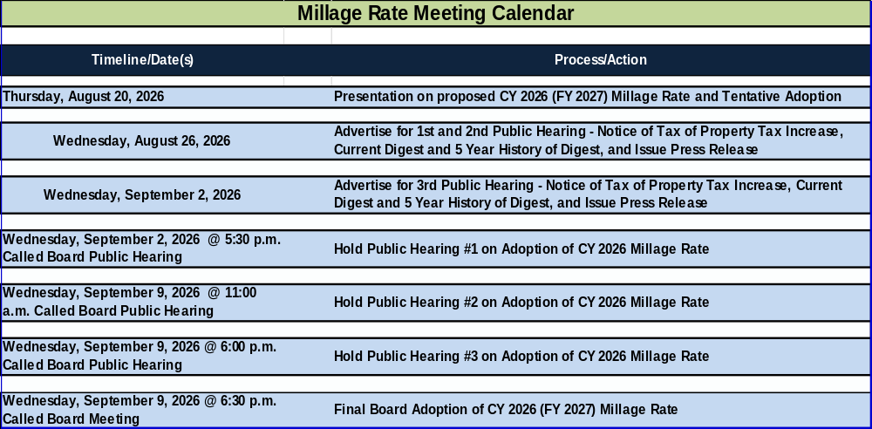
CALENDAR OF EVENTS – MILLAGE ADOPTION

Slide 31

Q&A

Slide 32
