Slide 1


School Consolidation Exploration:
Assessing Opportunities for Efficiency and Student Success
Dr. Katika Lovett, Deputy Superintendent
Thelron Pleas, Towering Your Success
April 17, 2025

Slide 2

AGENDA
Overview
Roadmap
School Consolidation Scenarios and Data
Non-School Consolidation Scenarios and Data
Recommendations
Next Steps
Takeaway
This presentation provides a data-driven analysis of school consolidation and non-consolidation options, culminating in recommendations to pursue districtwide rezoning and an organizational efficiency study to support long-term strategic decision-making.
Through a data-driven and community-informed approach, the Bibb County School District has carefully analyzed consolidation and non-consolidation scenarios to ensure that any future decisions prioritize student success, equitable resource allocation, and long-term operational efficiency.

Slide 3

OUR MISSION
The Bibb County School District maximizes student achievement and social-emotional well-being by building a sense of community in safe, equitable learning environments.
OUR VISION
Students are empowered to learn, lead, innovate and serve as productive and caring citizens within their chosen paths of success.

Slide 4


OUR GUIDING PRINCIPLES
OUR GOALS
LEARNER
OUTCOMES
Student Achievement
Staff Effectiveness
Stakeholder Engagement
Each student
will graduate empowered to make a well-informed decision about their next step. They will learn about themselves as they engage in rigorous content and gain exposure through personalized learning experiences, thereby enlightening them to choose their most meaningful pathway.
Personalized Learning
Collaboration
Engagement
Safety
Effective Leadership

Slide 5
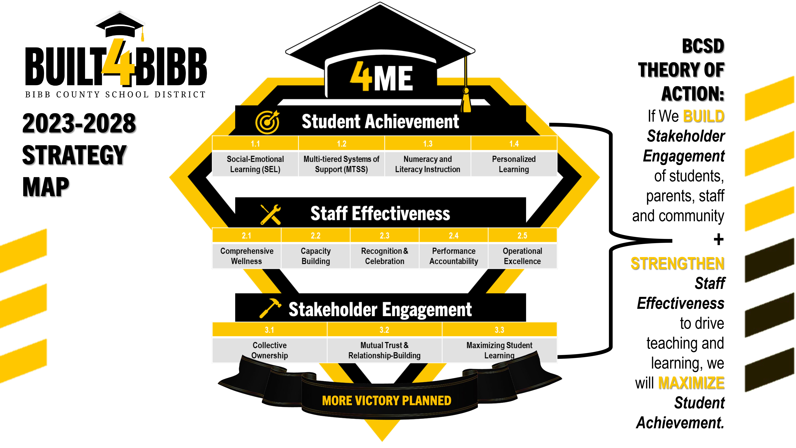

Slide 6



Timeline OVERVIEW
Phase 1
Planning
Phase 2
Data Collection and Analysis
Phase 3
Community
Phase 4
Decision
Making
Planning
Engagement
and
Feedback
and
and
Preparation
Pre-Phase (SY2024-2025)
Board Request for School Consolidation Exploration
July-Aug 2024
Sept-Nov 2024
Nov 2024 -Feb 2025
March-May 2025

Slide 7
CORE ELEMENTS OF THE PROCESS
Transparency: Maintain open lines of communication throughout the process, ensuring all stakeholders, especially students, are informed and heard.
Equity: Ensure that consolidation decisions do not disproportionately impact any particular group and enhance equitable access to resources and opportunities.
Student Support: Provide resources and support for students affected by the consolidation, including counseling, academic support, and extracurricular opportunities.
Financial Efficiency: Conduct a thorough analysis of potential cost savings and financial implications. Identify opportunities for increased efficiency and effectiveness through consolidation while maintaining or improving education outcomes.
Future Budget Planning: Integrate school consolidation considerations into future budget planning processes. Provide recommendations and strategies for long-term financial planning.

Slide 8
WHAT IS SCHOOL CONSOLIDATION?
School consolidation involves merging two or more schools, typically to create a single, more efficiently operated institution. This process is often pursued by school districts to address issues like declining enrollment, underutilized facilities, or budget constraints. By consolidating schools, districts aim to improve resource allocation, optimize staffing, and enhance educational offerings.

Slide 9
WHY WE EXPLORED SCHOOL CONSOLIDATION?
Reasons for Consolidation Exploration:
Analyze the impacts of declining enrollment
Address underutilized and aging facilities
Ensure equitable access to resources and programs
Enhance operational efficiency and financial sustainability
Improve resource allocation and support for students

Slide 10
HOW WAS THE PROCESS CONDUCTED?
Data Analysis and Comparative Research: Enrollment trends, building utilization, financial costs using 7-point Consolidation Matrix
Stakeholder Engagement: Steering committee meetings, surveys, focus groups, community meetings (Fall 2024–Spring 2025)
Scenario Modeling: Developed (3) school consolidation and (2) non-consolidation options

Slide 11
COMMUNITY ENGAGEMENT HIGHLIGHTS
7 school-based community meetings: Williams ES, Hartley ES, Porter ES, Heard ES, Skyview ES, Southfield ES, and Ingram-Pye ES.
Monthly Steering Committee Meetings
2 in-person and 1 virtual districtwide town halls
Recurring themes included:
  Neighborhood preservation
  Transportation & accessibility
  Class size & staff assignments
  Student well-being

Slide 12
CONSOLIDATION SCENARIOS

Slide 13

BCSD SCHOOL CONSOLIDATION SCENARIOS
Scenario A (Hartley) | Scenario B (Williams) | Scenario C (Porter)
Hartley Elementary School would consolidate with 2 elementary schools. Hartley Elementary students would attend: Ingram-Pye Elementary Southfield Elementary Middle school and high school enrollment would remain the same, with student addresses for Hartley neighborhoods attending Ballard MS & Southwest HS | Williams Elementary School would consolidate with 2 elementary schools. Williams Elementary students would attend: Ingram-Pye Elementary Hartley Elementary Middle school and high school enrollment would remain the same, with student addresses for Williams neighborhoods attending Miller MS & Central HS | Porter Elementary School would consolidate with 2 elementary schools. Porter Elementary students would attend: Heard Elementary Skyview Elementary Middle school and high school enrollment would remain the same, with student addresses for Porter neighborhoods attending Rutland MS & Rutland HS

Slide 14
Consolidation Data – Student Enrollment

Slide 15
Consolidation Data – Cost Savings – Scenario A
Hartley Elementary | FTE | Average Salary & Benefit per Position | Total Estimated Savings | Operations | Total Potential Savings
Principal | 1 | 172,500.00 | 172,500.00
Assistant Principal | 1 | 131,500.00 | 131,500.00
Media Spec. | 1 | 129,500.00 | 129,500.00
Media Clerk | 0.5 | 39,500.00 | 19,750.00
Secretary | 1 | 73,000.00 | 73,000.00
Office Clerk | 1 | 59,000.00 | 59,000.00
Registrar | 1 | 70,500.00 | 70,500.00
Head Custodian | 1 | 62,300.00 | 62,300.00
Custodians | 1.5 | 38,750.00 | 58,125.00
Total General Fund Positions | 9 |  | 776,175.00 |  | 776,175.00
Operational Cost
Electricity |  |  |  | 70,000.00
Water |  |  |  | 8,500.00
Natural Gas |  |  |  | 5,500.00
Phone & Internet |  |  |  | 8,000.00
Garbage |  |  |  | 5,000.00
Office Supplies |  |  |  | 3,000.00
Total Operational Savings |  |  |  | 100,000.00 | 100,000.00
Total Potential General Fund Savings |  |  |  |  | 876,175.00
School Nutrition Services
School Nutrition Manager | 1 | 63,000.00 | 63,000.00
SNS Assistants | 4 | 35,000.00 | 140,000.00
 | 5 |  | 203,000.00

Slide 16
Consolidation Data – Cost Savings – Scenario B
Williams Elementary | FTE | Average Salary & Benefit per Position | Total Estimated Savings | Operations | Total Potential Savings
Principal | 1 | 172,500.00 | 172,500.00
Assistant Principal | 1 | 131,500.00 | 131,500.00
Media Spec. | 1 | 129,500.00 | 129,500.00
Media Clerk | 0.5 | 39,500.00 | 19,750.00
Secretary | 1 | 73,000.00 | 73,000.00
Office Clerk | 1 | 59,000.00 | 59,000.00
Registrar | 1 | 70,500.00 | 70,500.00
Head Custodian | 1 | 62,300.00 | 62,300.00
Custodians | 2.5 | 38,750.00 | 96,875.00
Total General Fund Positions | 10 |  | 814,925.00 |  | 814,925.00
Operational Cost
Electricity |  |  |  | 65,000.00
Water |  |  |  | 8,000.00
Natural Gas |  |  |  | 5,500.00
Phone & Internet |  |  |  | 7,000.00
Garbage |  |  |  | 4,500.00
Office Supplies |  |  |  | 3,000.00
Total Operational Savings |  |  |  | 93,000.00 | 93,000.00
Total Potential General Fund Savings |  |  |  |  | 907,925.00
School Nutrition Services
School Nutrition Manager | 1 | 63,000.00 | 63,000.00
SNS Assistants | 4 | 35,000.00 | 140,000.00
 | 5 |  | 203,000.00

Slide 17
Consolidation Data – Cost Savings – Scenario C
Porter Elementary | FTE | Average Salary & Benefit per Position | Total Estimated Savings | Operations | Total Potential Savings
Principal | 1 | 172,500.00 | 172,500.00
Assistant Principal | 1 | 131,500.00 | 131,500.00
Media Spec. | 1 | 129,500.00 | 129,500.00
Media Clerk | 0.5 | 39,500.00 | 19,750.00
Secretary | 1 | 73,000.00 | 73,000.00
Office Clerk | 1 | 59,000.00 | 59,000.00
Registrar | 1 | 70,500.00 | 70,500.00
Head Custodian | 1 | 62,300.00 | 62,300.00
Custodians | 1 | 38,750.00 | 38,750.00
Total General Fund Positions | 8.5 |  | 756,800.00 |  | 756,800.00
Operational Cost
Electricity |  |  |  | 60,000.00
Water |  |  |  | 11,000.00
Natural Gas |  |  |  | 5,500.00
Phone & Internet |  |  |  | 7,000.00
Garbage |  |  |  | 5,000.00
Office Supplies |  |  |  | 3,000.00
Total Operational Savings |  |  |  | 91,500.00 | 91,500.00
Total Potential General Fund Savings |  |  |  |  | 848,300.00
School Nutrition Services
School Nutrition Manager | 1 | 63,000.00 | 63,000.00
SNS Assistants | 4 | 35,000.00 | 140,000.00
 | 5 |  | 203,000.00

Slide 18
CONSOLIDATION DATA – TRANSPORTATION
BCSD CONSOLIDATION - PRELIMINARY SCENARIO (A) (Hartley to Ingram Pye and Southfield)
School | Current Riders | Current Buses | Projected Additional Riders From Hartley | Additional Buses | Projected Cost 26-27
Hartley | 123 | 4 | 0 | 0
Ingram-Pye | 137 | 4 | 180 | 3 | $156,000.00
Southfield | 384 | 10
BCSD CONSOLIDATION - PRELIMINARY SCENARIO (B) (Williams to Ingram Pye and Hartley)
School | Current Riders | Current Buses | Projected Additional Riders From Williams | Additional Buses | Projected Cost 26-27
Williams | 129 | 3 | 0 | 0
Ingram-Pye | 137 | 4 | 116 | 2 | $104,000.00
Hartley | 123 | 4
BCSD CONSOLIDATION - PRELIMINARY SCENARIO (C) (Porter to Heard and Skyview)
School | Current Riders | Current Buses | Projected Additional Riders From Porter | Additional Buses | Projected Cost 26-27
Porter | 205 | 4 | 0 | 0
Heard | 262 | 10 | 138 | 3 | $156,000.00
Skyview | 197 | 11
NOTE: The projected additional riders include the total number of students between the 2 receiving schools.

Slide 19
NON-CONSOLIDATION SCENARIOS

Slide 20
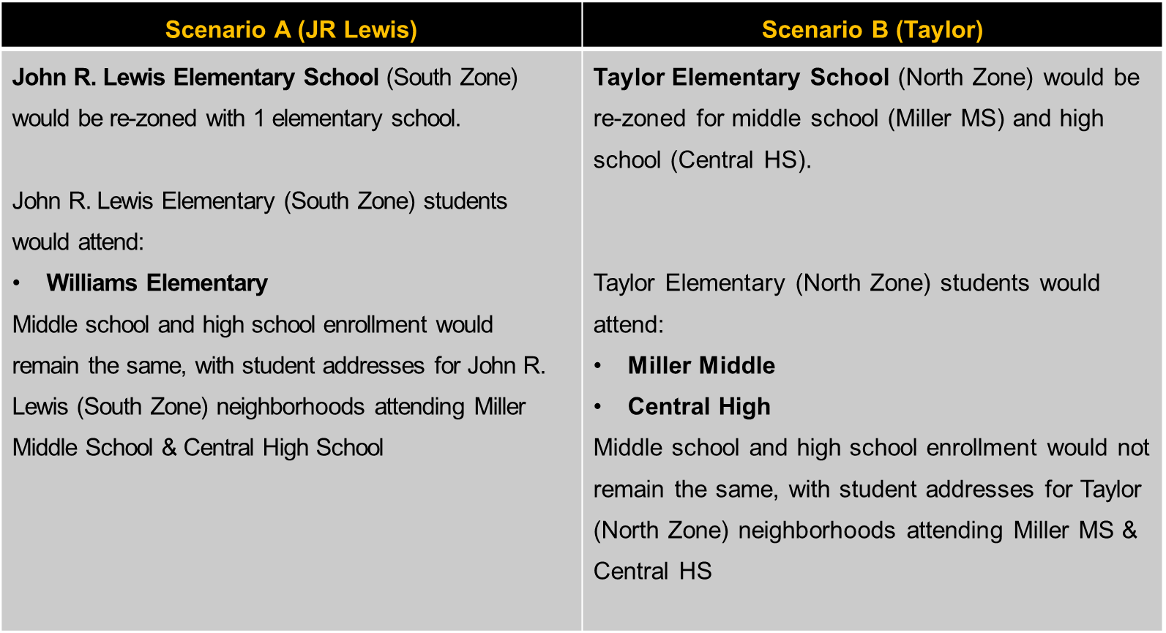
BCSD NON-CONSOLIDATION SCENARIOS

Slide 21
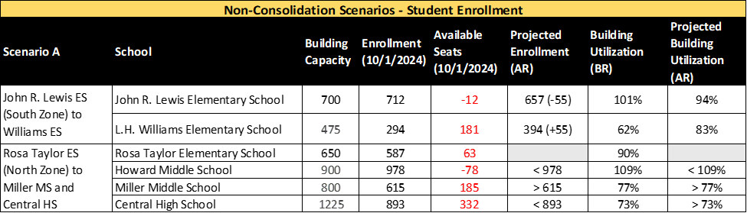
NON-CONSOLIDATION DATA – STUDENT ENROLLMENT
349 (+55)
73%
*BR = Before Rezoning | *AR = After Rezoning

Slide 22
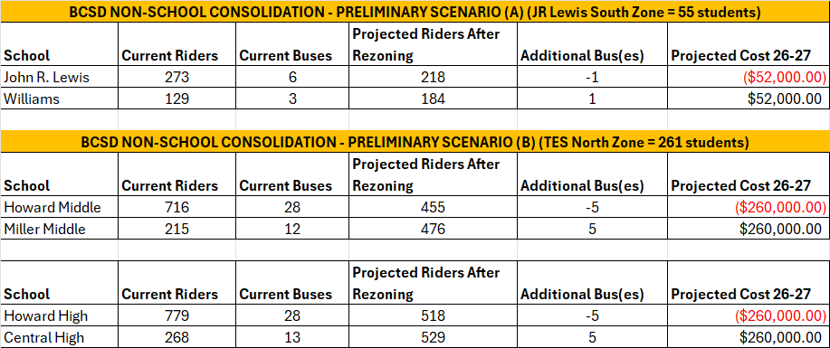
NON-CONSOLIDATION DATA – TRANSPORTATION

Slide 23
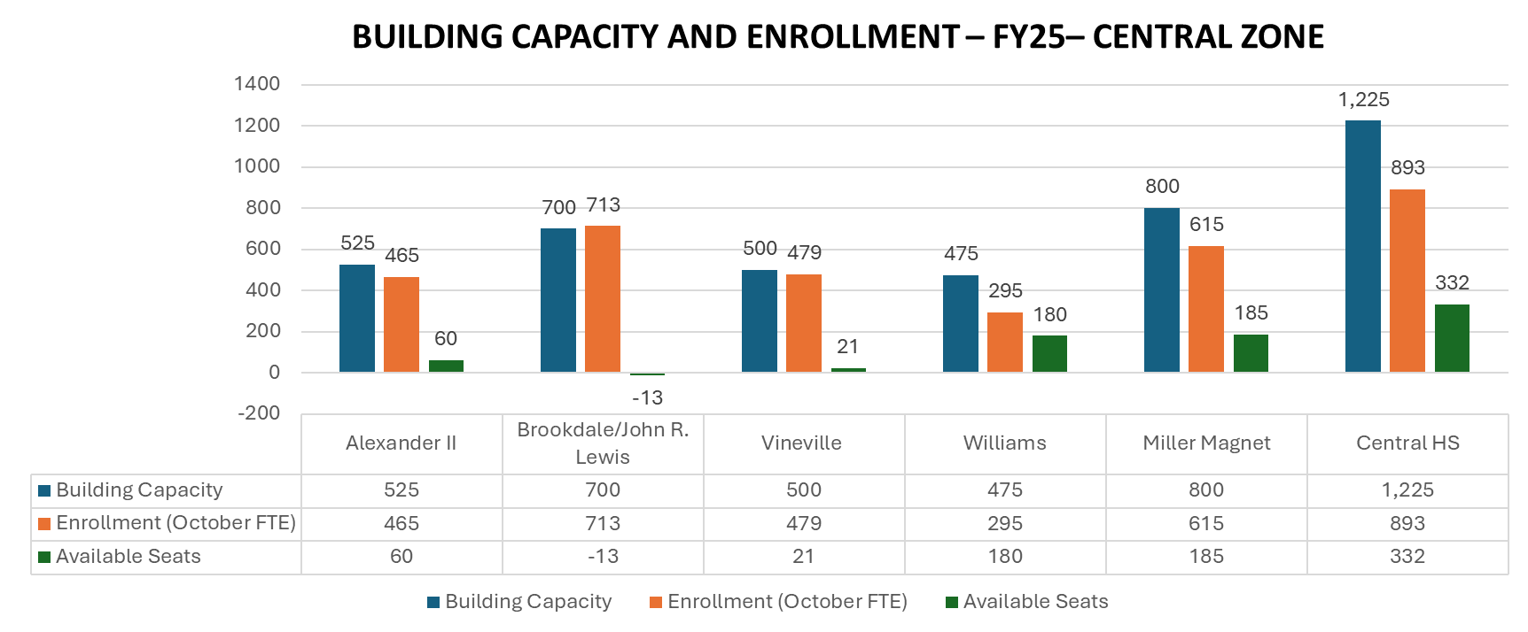
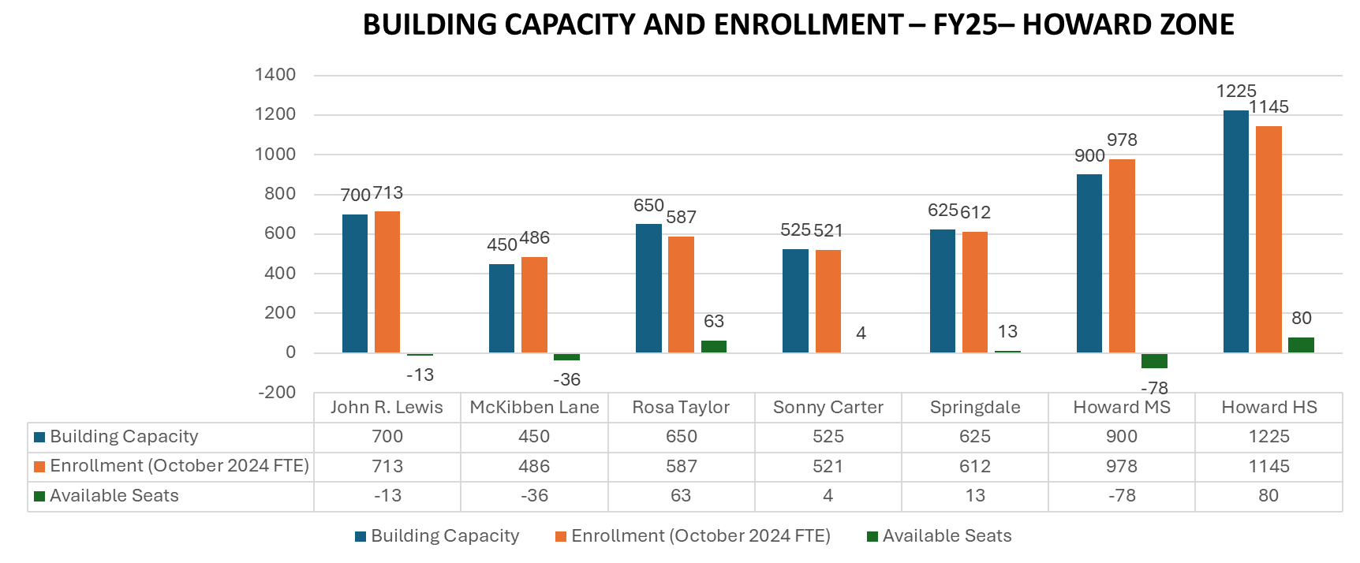
NON-CONSOLIDATION DATA – COST SAVINGS REVIEW
Based on the cost savings review for the Non-Consolidation Scenarios, there are no significant cost savings for Non-Consolidation Scenario A or Non-Consolidation Scenario B.
Based on the cost savings review for the Non-Consolidation Scenarios, there are no anticipated financial implications for building-level, non-instructional costs.
The overall benefit of the Non-Consolidation Scenarios is the stabilization of building utilization for schools above and below building capacity in the Central and Howard Zones.

Slide 24
RECOMMENDATIONS

Slide 25
RECOMMENDATION #1: EXPLORE DISTICTWIDE REZONING
Why Consider Rezoning Instead of Consolidation FIRST?
Balances enrollment without closing schools
Preserves community identity and neighborhood ties
Improves building utilization and staffing efficiency
Supports equity in access to programs and services
Notes:
Generated by Copilot

Slide 26
RECOMMENDATION #1: EXPLORE DISTICTWIDE REZONING
Why Rezoning May Be the Better Fit for Immediate Next Steps:
School buildings are still in good condition.
Declining enrollment is not yet severe.
Community engagement shows strong preference for school preservation.
There are opportunities to assess boundaries strategically and solve imbalance issues based on individual school needs.

Slide 27
RECOMMENDATION #2: ORGANIZATIONAL EFFICIENCY STUDY
Complete an Organizational Efficiency Study as a Strategic Alternative to Immediate School Consolidation:
  Purpose: Assess leadership structure across the district including central office and explore districtwide facility use
  Timeline: May 2025 (RFP release) – July 2025 (Board presentation)
  Outcome: Long-term strategy for improving district efficiency and cost savings
Notes:
______

Slide 28
RECOMMENDATION #2: ORGANIZATIONAL EFFICIENCY STUDY
Why Complete an Organizational Efficiency Study?
Takes a Holistic View of District Operations
Provides Independent, Data-Driven Analysis
Identifies Multiple Cost-Saving Strategies
Supports Informed Stakeholder Engagement
Aligns with Strategic Planning

Slide 29
NEXT STEPS
Release an RFP for the organizational efficiency study.
Develop plans for exploring rezoning.

Slide 30

Q&A

Slide 31
APPENDIX

Slide 32
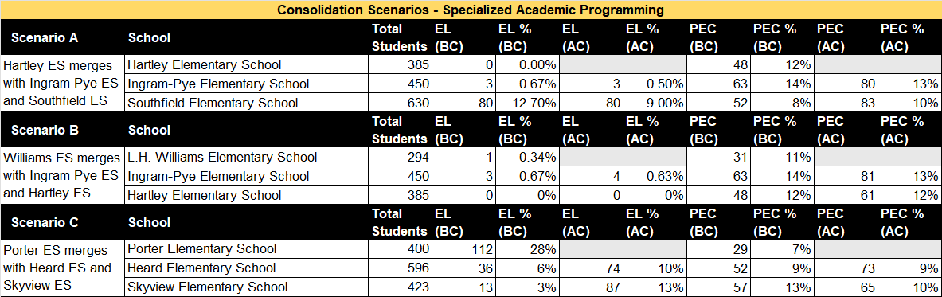
Consolidation Data – Specialized Academic Programming
*BC = Before Consolidation | *AC = After Consolidation
EL= English Learners
PEC = Program for Exceptional Children (Special Education)
EIP = Early Intervention Program

Slide 33
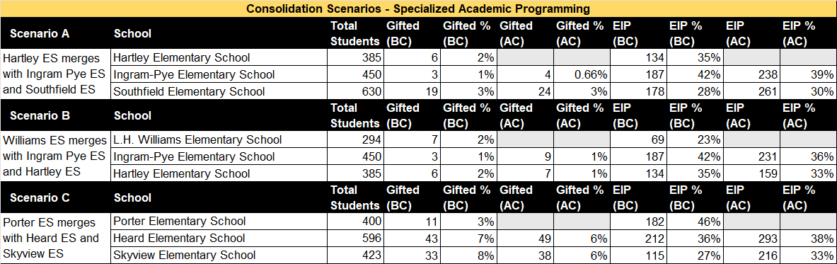
Consolidation Data – Specialized Academic Programming
*BC = Before Consolidation | *AC = After Consolidation
EL= English Learners
PEC = Program for Exceptional Children (Special Education)
EIP = Early Intervention Program

Slide 34
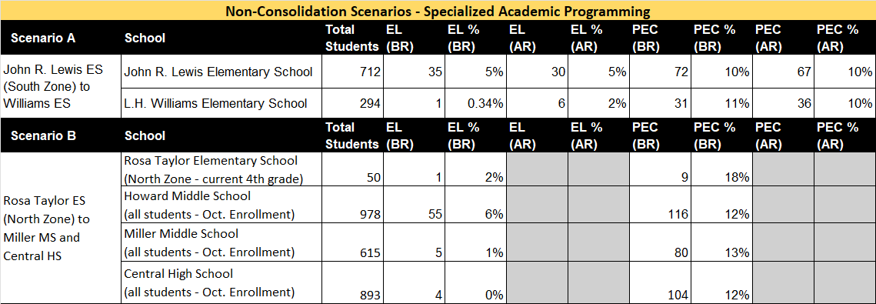
Non-Consolidation Data – Specialized Academic Programming
*BR = Before Rezoning | *AR = After Rezoning

Slide 35
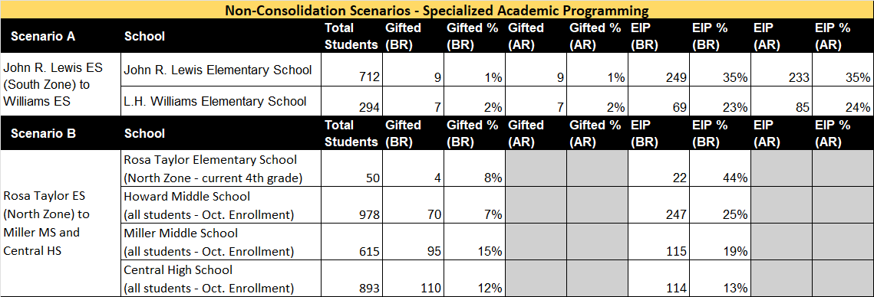
Non-Consolidation Data – Specialized Academic Programming
*BR = Before Rezoning | *AR = After Rezoning

Slide 36
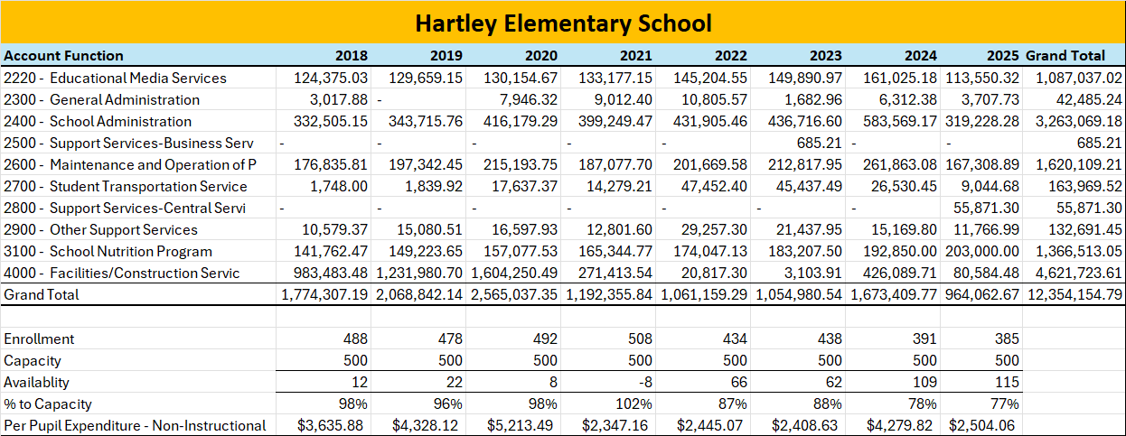
Consolidation Data – Non-Instructional Cost Study – Scenario A

Slide 37
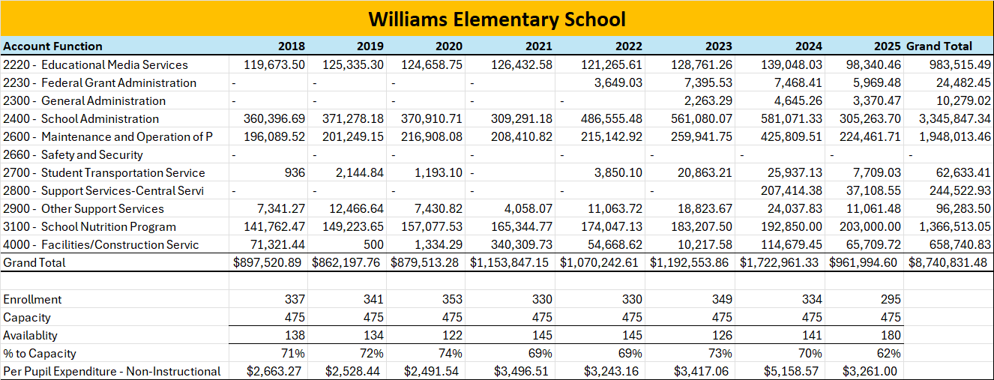
Consolidation Data – Non-Instructional Cost Study – Scenario B

Slide 38
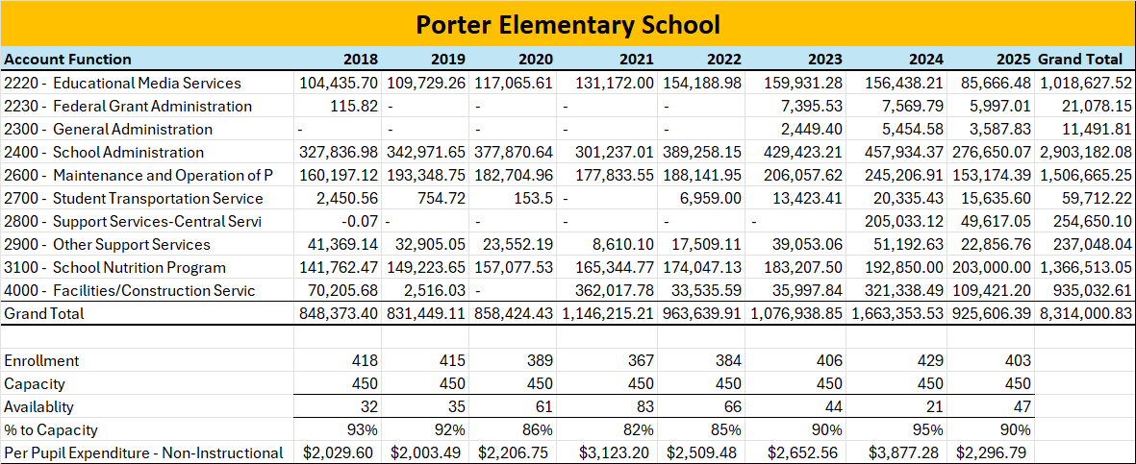
Consolidation Data – Non-Instructional Cost Study – Scenario C

